Slide 1
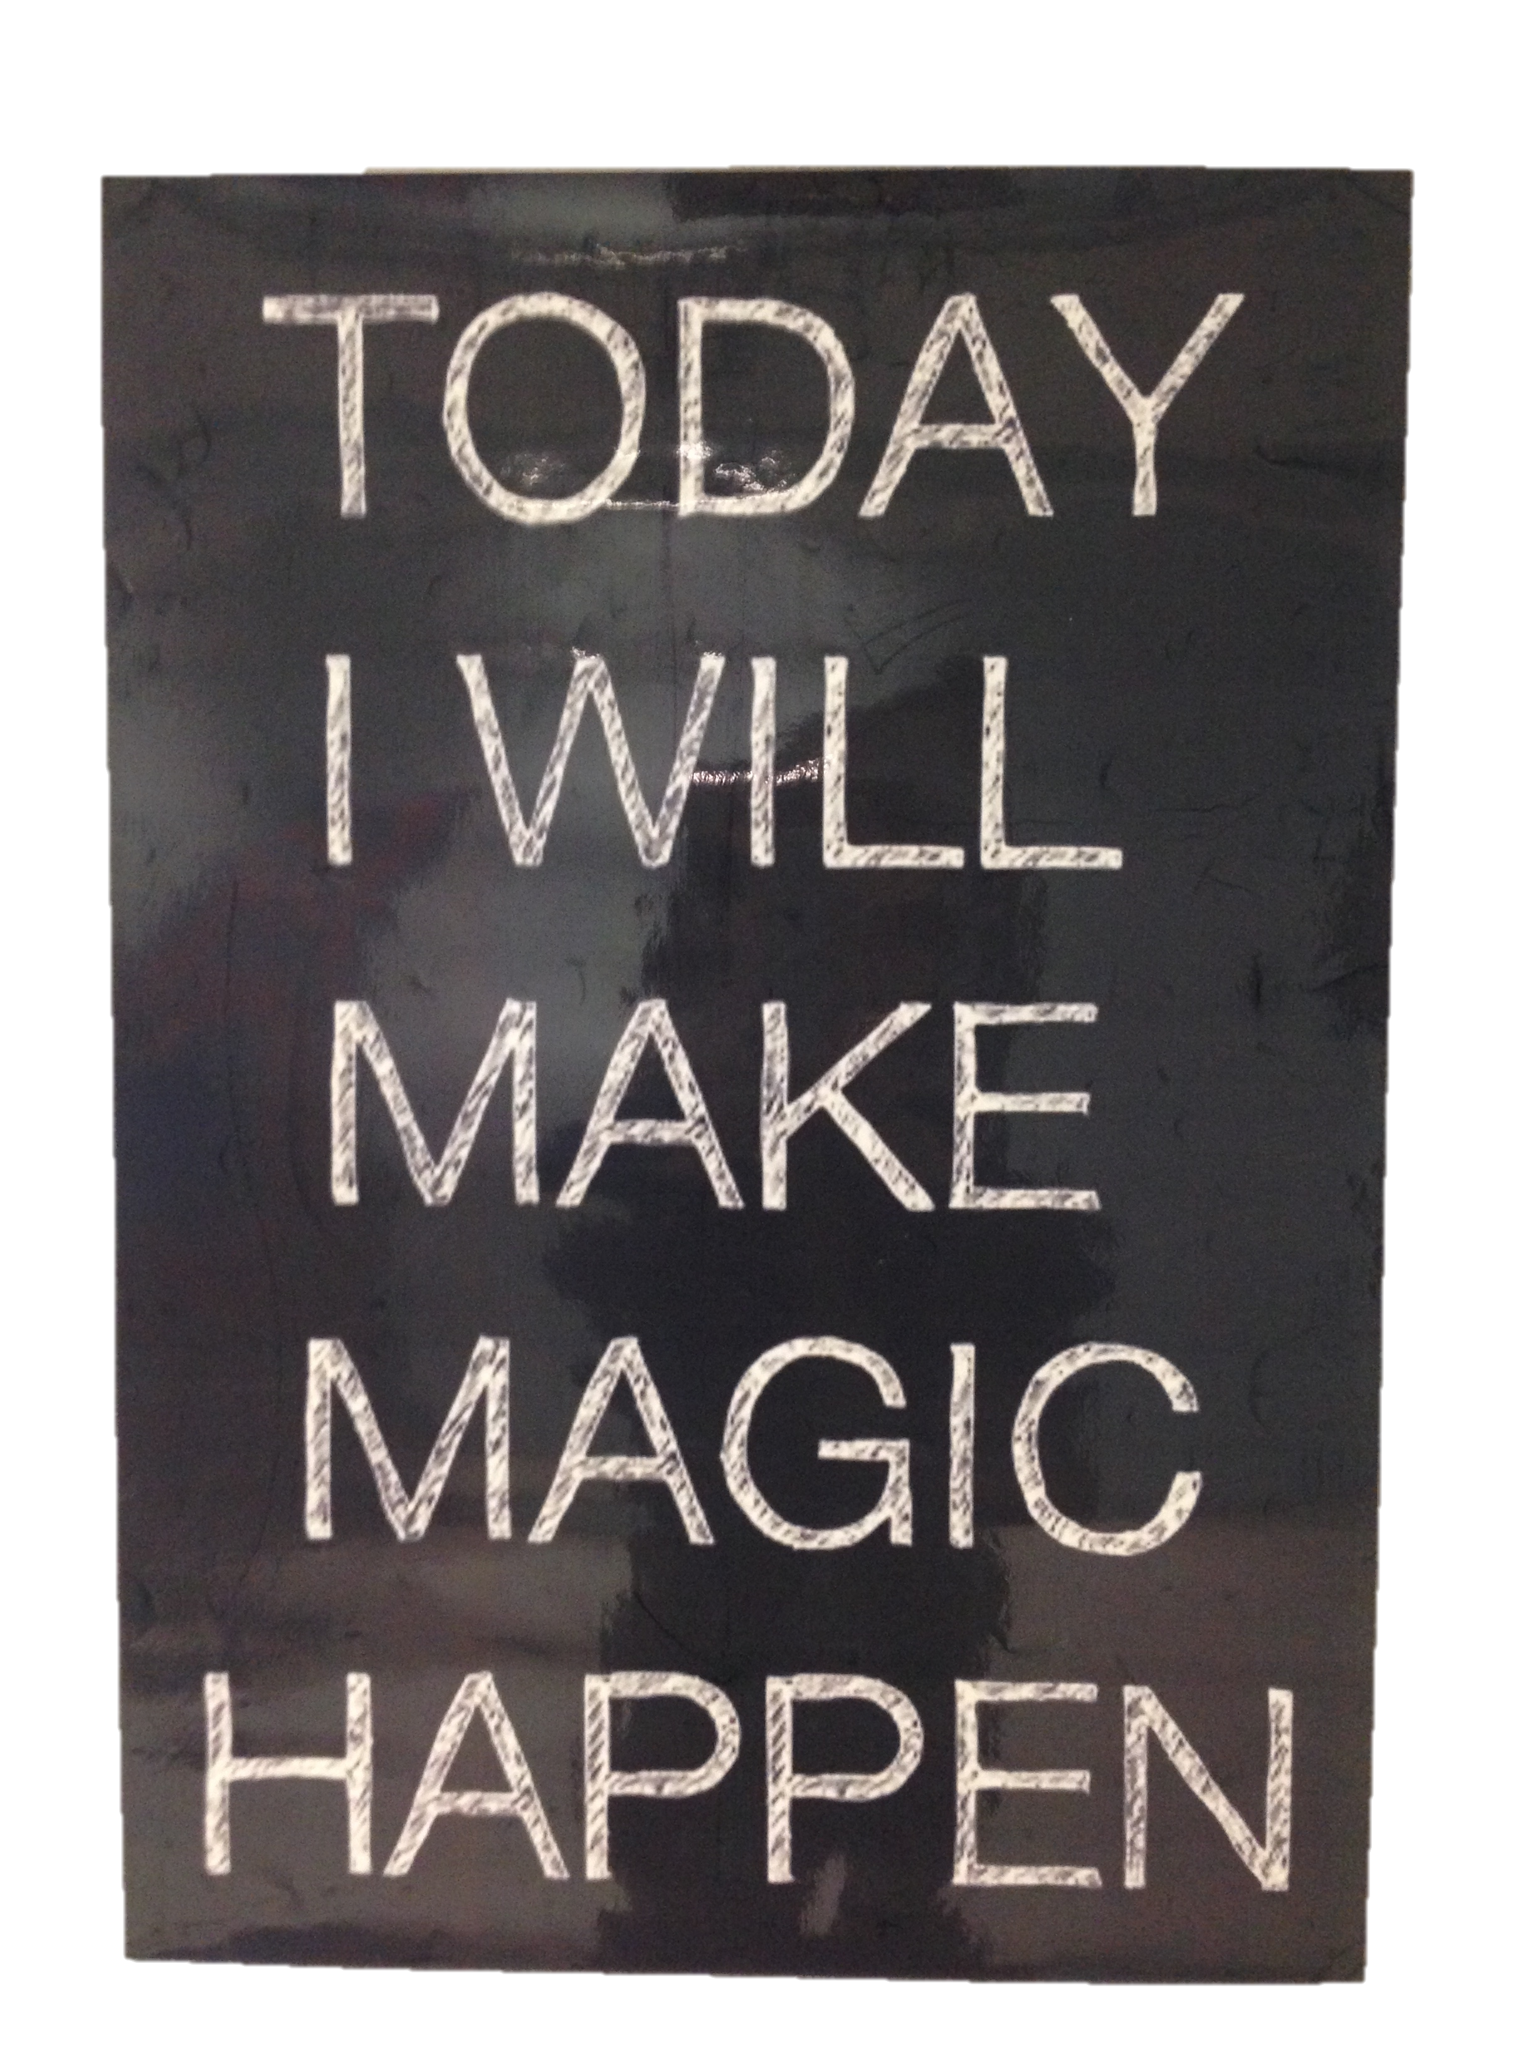
Tell Me Why:
Building a Culture
of Success and
High Expectations
Rick Fisher
Allen Co. Schools
Scottsville, Kentucky

Slide 2
Mrs. Nancy Stinnett – 4th Grade Teacher
Mrs. Georgiana Fisher –
Supervising Teacher
Mr. Tommy Keen – 1st Principal
Mr. Howard Crittenden - Mentor

Slide 3
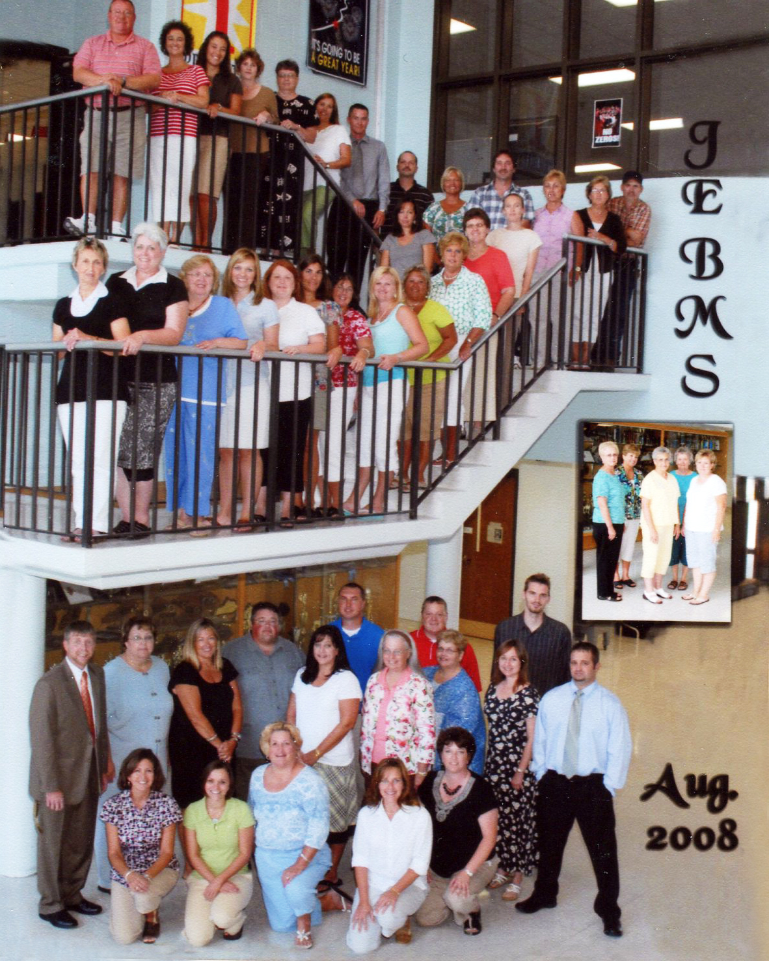
2008
Bazzell
Middle School
Team Picture

Slide 4
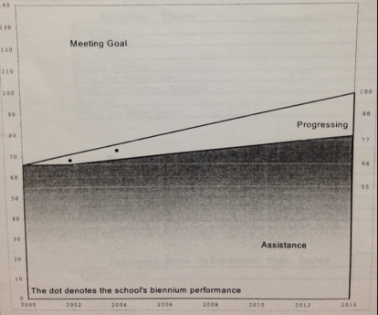
Top 10%
# 3 in Math
100
2008
2014

Slide 5
How is school culture
like a cup of coffee?

Slide 6
Why
What
How

Slide 7
Purpose?
“Leadership is the ability to rally people not for a single event, but for
years.”

Slide 8
Leaders understand they must win hearts before minds. They start with why.
Why?

Slide 9
“It is not logic & facts but our hopes and dreams, our
hearts and our guts, that drive
us to try new things.”
Why?

Slide 10
People want
to believe in
something that
is bigger than themselves. Connection must define the user. Association with it symbolizes them.
Why?

Slide 11
All the inspiring leaders and companies, regardless of their size or industry, think, act, and communicate exactly alike...
And that is completely different from everyone else.
Simon Sinek

Slide 12
Expectations
Vision
Beliefs
Values
Create your own narrative.

Slide 13
You and I have a rendezvous with destiny. We will preserve for our children this, the last best hope of man on earth, or we will sentence them to take the first step into a thousand years of darkness. If we fail, at least let our children and our children’s children say of us we justified our brief moment here. We did all that could be done.
Ronald Reagan

Slide 14
rick fisher 2014

Slide 15
Develop Mission/VIsion
Each staff member gets a post-it note pad.
Each person thinks of what they want the school to become and writes each idea on a post-it.
Arrange into groups of five.
Put notes on chart paper.
Read each note on the chart paper.
Arrange notes into categories or classifications.
Each group writes a statement that describes the vision of the classifications.
A writing committee collects the statements and writes a draft vision statement.
The draft is shared will all staff and in small groups, revisions are suggested.
The writing committee takes suggestions and makes clarifications and makes changes deemed appropriate.
The new draft is shared with all staff.
Each staff member is asked if they believe the vision statement is meaningful and if they don’t, identify changes that would make it more meaningful to them.
Each staff member is asked if they can commit or “own” the statement.
Adapted from the work of Dufour and Eaker
Professional Learning Communities that Work 1998

Slide 16
Core Values
WE VALUE A SCHOOL WHERE:
EACH STAFF MEMBER SUPPORTS, CHALLENGES, AND ENCOURAGES ALL STUDENTS
OUR REPUTATION IS ONE OF EXCELLENCE
EACH STAFF MEMBER IS GIVEN THE OPPORTUNITY TO IMMERSE IN PROFESSIONAL STUDIES AND GROWTH IN THE FIELD OF EDUCATION
WE VALUE AN INSTRUCTIONAL ENVIRONMENT WHERE:
TEACHERS USE DIVERSE, CREATIVE, AND INSPIRING INSTRUCTIONAL STRATEGIES TO MEET THE UNIQUE LEARNING STYLES OF EVERY STUDENT
TEACHERS USE A VARIETY OF ASSESSMENT STRATEGIES TO ENHANCE STUDENT PERFORMANCE
WE VALUE A SCHOOL WHERE GOOD RELATIONSHIPS ARE FOSTERED:
BY WORKING TOGETHER IN TEAMS TO ENHANCE LEARNING AND SOLVE PROBLEMS
BY BUILDING TRUSTING AND SUPPORTIVE RELATIONSHIPS WITH STUDENTS
rick fisher 2014

Slide 17
High Expectations
Exceptional
Education
CHAMPS
Principal
Filter
Coach
Everybody works on the school work.
rick fisher 2014

Slide 18
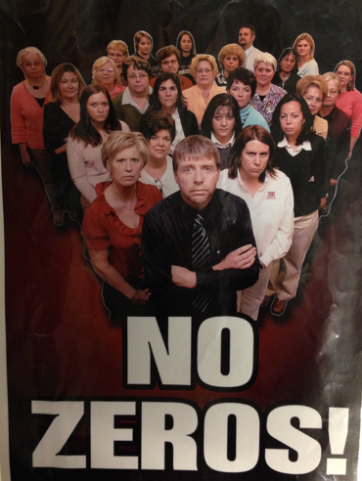
The penalty for not
doing your work
is doing your work
Doug Reeves
rick fisher 2014

Slide 19
Focus:
“Commit entirely to what is essential
and ignore the rest” Collins 2001

Slide 20
How is it the Same?
Thoughtful Ed.
Mastery
Exemplars/Models
Workshop
Flexible Grouping
Hook
Focused Revision
Grading
Visualizing
Think Link
Unit Development
Learning Team
Questioning
Literacy/ Thinking Strategies
Learning Styles
RTI
GT
Professional Learning Community
Inference
Interpersonal
Self Expressive
Student Centered
Making Connections
Self Assessment
Formative Assessment
Synthesis
Think Aloud
Technology
Learning Targets
Interventions
Essential Question
Gradual Release
Determine Importance
Common Assessment
Pre/Post Test
Pause Day
Reflections
Unit Reviews
Understanding Style

Slide 21
Shaping the Ball
Teaching
Tools
Pedagogy
Professional
Learning
Formative
Assessment
rick fisher 2014

Slide 22
Pedagogy
Teachers present
the ideas to rest of faculty and provide expert support.
Use teacher
Leaders to “Pilot” new initiatives.
Divide faculty into heterogeneous
learning teams.
Faculty meets back
monthly to share
student work and
discuss progress.
rick fisher 2014

Slide 23
Professional learning
Literacy Strategies
Thoughtful Classroom
Marzano 9
Writing
Grade level content teachers plan units together. Focus on understanding.
Common unit tests.
Quarterly Scrimmages.
Benchmarks
Curriculum Map
Peer Observation
Debriefs
Data Teams
Unit Review
rick fisher 2014

Slide 25
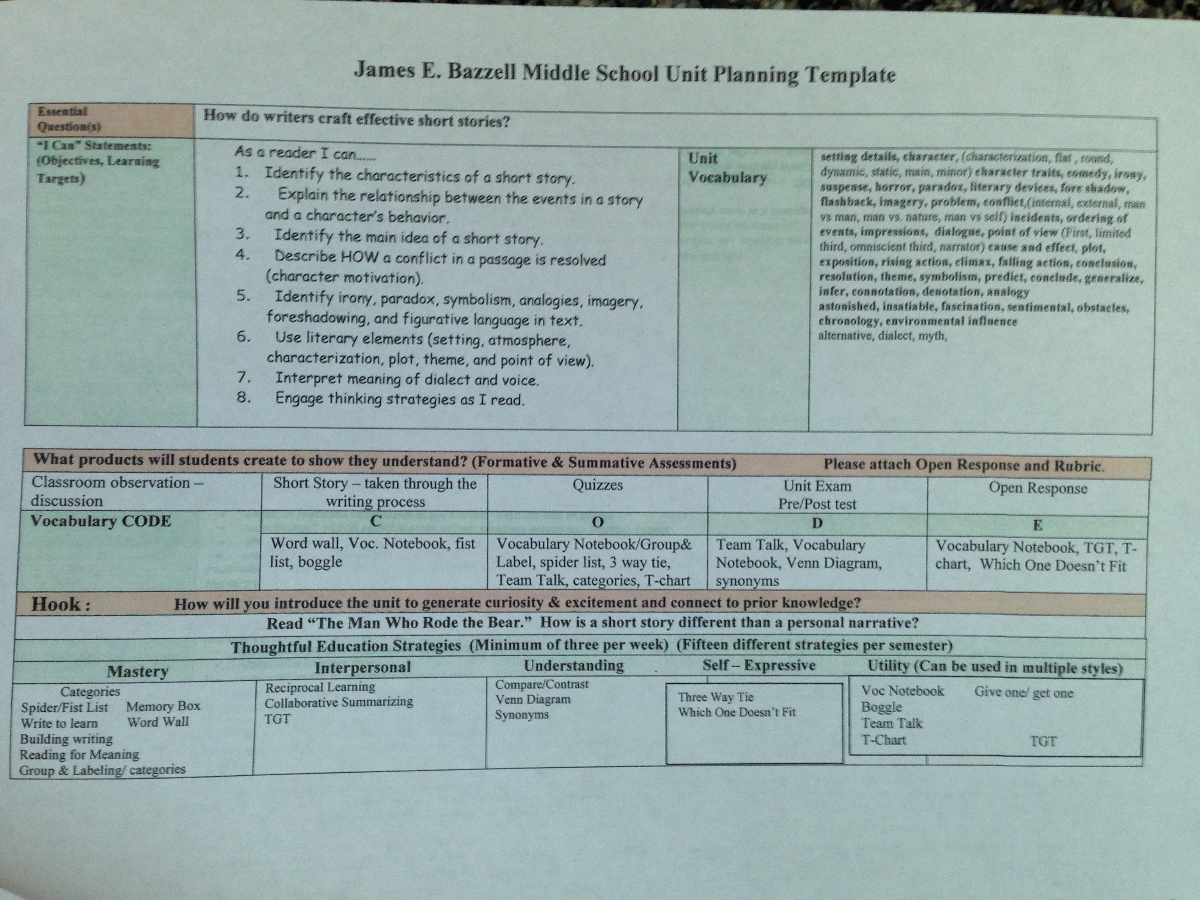

Slide 26
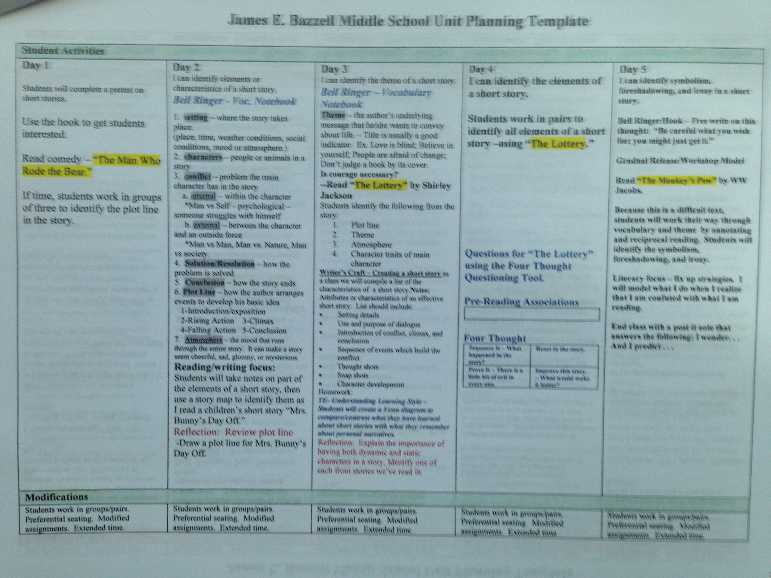

Slide 27
Formative Assessment
Separate grades from fluff.
Don’t grade practice.
Offer Retests.
Teach
Assess
Pause/Reteach
Repeat
Data Teams
Pre test
During
After
Pre Test
Quarterly Scrimmages.
Benchmarks
rick fisher 2014

Slide 28
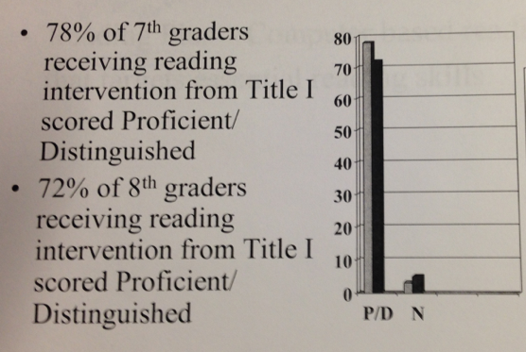
rick fisher 2014

Slide 29
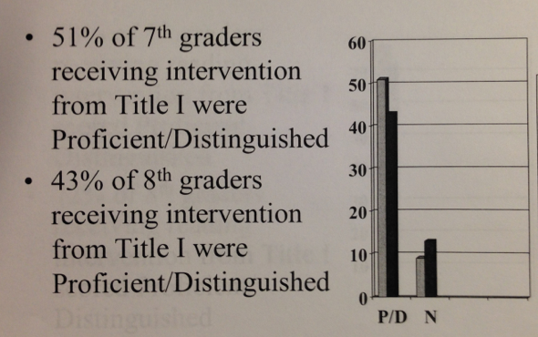
rick fisher 2014

Slide 30
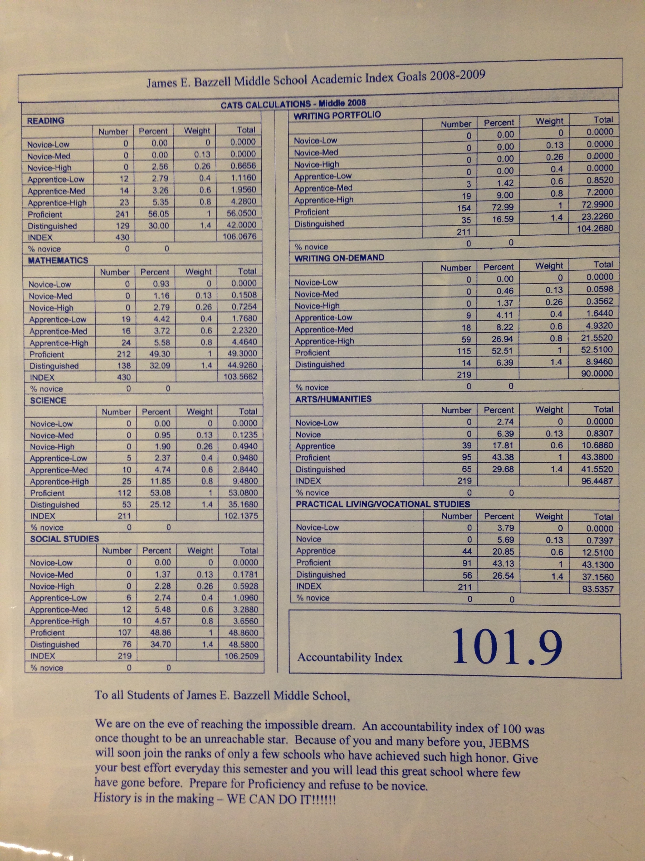
Goals chart which
is placed above every
copy machine,
water fountain, and
bathroom entrance.
rick fisher 2014

Slide 31
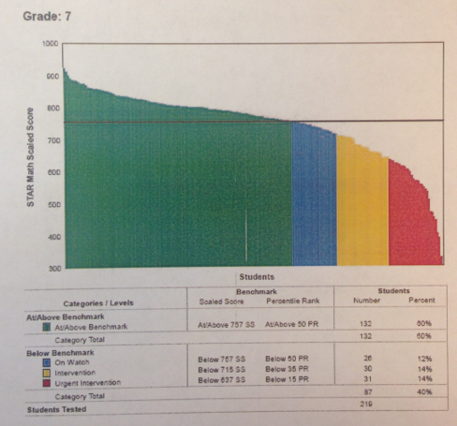
Benchmark
Testing using
STAR Reading &
STAR Math.

Slide 32
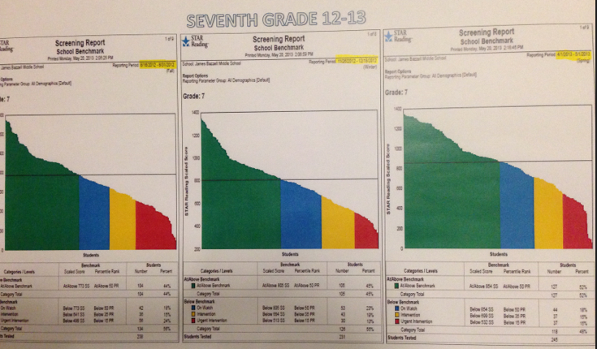

Slide 33
Hiring the Next Generation
Interview
Compelling Nature
Interview
Pedagogy
Knowledge
Mentors
Works with team to get acclimated.
Year long
Performance
Teach a class
rick fisher 2014

Slide 34
High Expectations
Students as Customers of Instruction
Student-Centered Classrooms
Professional Learning
Assessment for Learning
Allen County Schools
rick fisher 2014

Slide 35
Thank YOU!
ricky.fisher@allen.kyschools.us
Rick Fisher
Allen Co. Schools
270-618-1463
http://www.allen.kyschools.us/
fisherrick.aspx

