Slide 1
Creating a Culture of Peer Learning Through Discourse, Writing and Reflection
By: monica blevins
2nd grade, Math

Slide 2
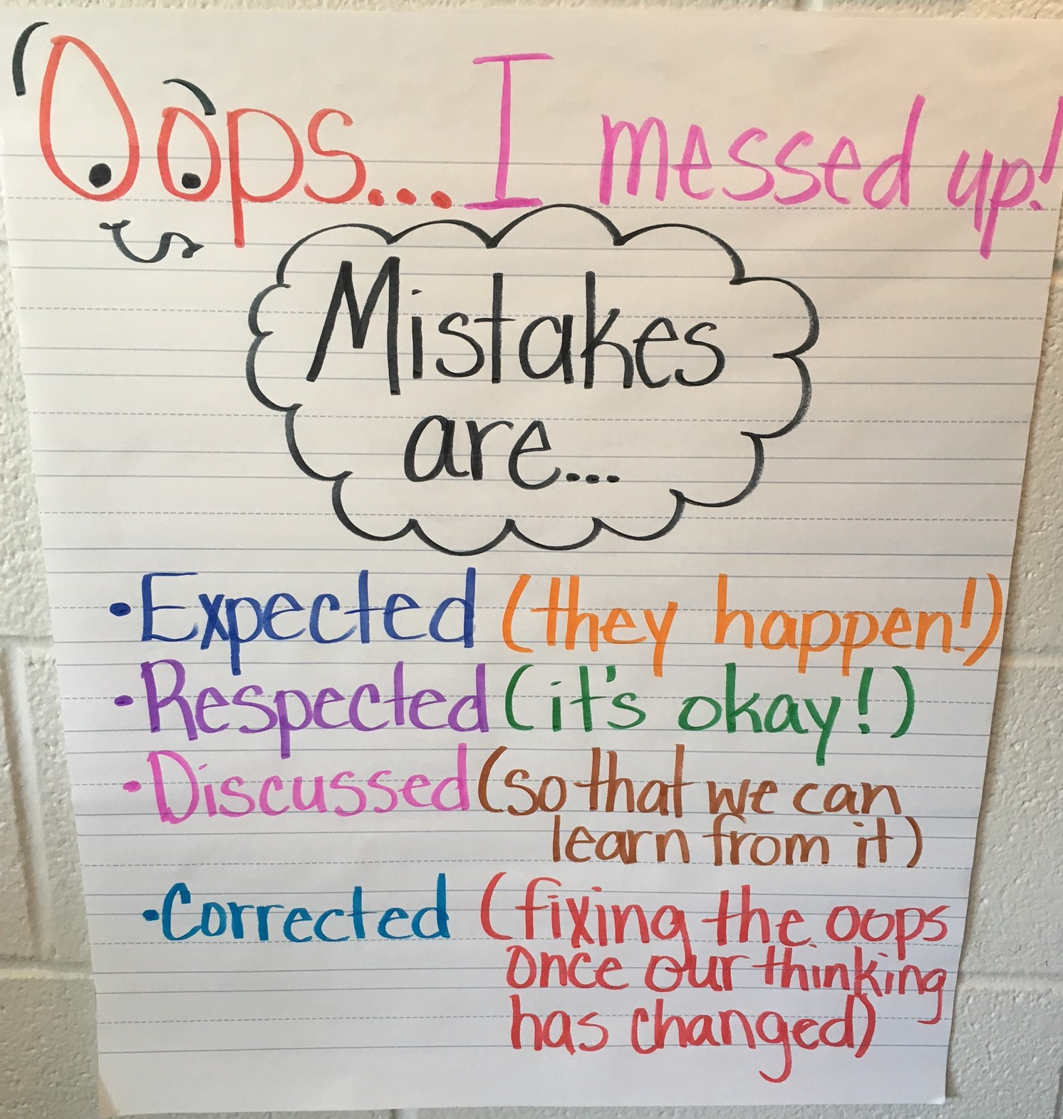
Creating a safe space FOR STUDENT DISCOURSE
In THE PAST: RIGHT IS RIGHT.
VS.
NOW: RIGHT IS RIGHT, BUT WRONG MEANS YOU TRIED!
IMPACT: STUDENTS ARE MORE OPEN TO SHARING THEIR THINKING, EVEN IF IT'S WRONG – INCREASED RISK, INCREASED REWARD

Slide 3
Building a Community of Learners
Subcomponent | (1) Novice | (2) Emergent All of 1, plus… | (3) Proficient All of 2, plus… | (4) Exemplar All of 3, plus…
Creates a climate of trust that allows for risk taking | Leads classroom discussions. | Leads discussions by inviting student thinking. Poses questions. Creates opportunities for students to make decisions and be leaders. | Co-creates classrooms climate with students Engages all in student-centered learning experiences. Poses open-ended questions that promote discussion. Models respect when addressing disagreements or misconceptions. Shares his/her own mistakes and self-corrections. | Apprentices students in facilitating their own discussions, allowing teacher to participate and provide additional insights. Teaches students strategies and vocabulary for respectful exchanges of ideas. Teaches students to hold each other accountable in their conversations about ideas and behavior.

Slide 4
STUDENT REFLECTION
In THE PAST: NO REFLECTION – STUDENT WORK/ASSESSMENTS USED AS the primary REFERENCE FOR WHAT STUDENTS KNOW
VS.
NOW: conferring and reflection used in addition to student work/assessments to assess students' learning
IMPACT: STUDENTS ARE GAINING IMPORTANT SKILLS, BUT ALSO THINKING ABOUT THEMSELVES AS MATHEMATICIANS

Slide 5
Implementing the Workshop Model of Instruction
Subcomponent | (1) Novice | (2) Emergent All of 1, plus… | (3) Proficient All of 2, plus… | (4) Exemplar All of 3, plus…
Provides opportunities for reflection | Reviews class activities after work time. | Reviews learning activities in light of objectives. | Asks students to reflect on what they learned and why it matters. | Invites students to consider what they are learning about themselves as learners. Encourages students to teach others what they learned as readers or writers.

Slide 6
MOVING FORWARD: writing
NOW: WRITING IS USED IN MATH SPORADICALLY
VS.
FUTURE PLANS: WRITING WILL BE INCORPORATED MORE CONSISTENTLY AS A MEANS FOR STUDENTS TO HOLD THEIR THINKING, ask questions, and reflect – Will serve as a springboard for reflection/debriefing
EXPECTED IMPACT: stronger mathematicians who have a deeper understanding of mathematical content

Slide 7
Applying the Thinking Strategies Across Content to Deepen Understanding
Subcomponent | (1) Novice | (2) Emergent All of 1, plus… | (3) Proficient All of 2, plus… | (4) Exemplar All of 3, plus…
Holds thinking to remember and reuse | Provides tools for students to hold thinking. | Shows students multiple ways to hold and use their thinking (sticky notes, double column journals, graphic organizers, etc.) | Matches the methods of holding thinking to the text and task. Demonstrates how students can use the "held" thinking in upcoming lessons. | Invites students to reflect on which ways of holding their thinking serve them best in different contexts. Creates ongoing needs for carefully "held" thinking. Offers structures for students to store and access"held" thinking over time.

