Slide 1
Continuum of Growth:
Implementing the Workshop Model of Instruction
Lesa Francis
5th grade/Science and Social Studies

Slide 2
Conducts crafting/mini/
focus lessons to model thinking
Provides learners blocks of time to work

Slide 3
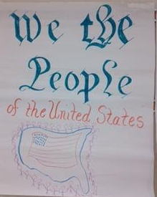
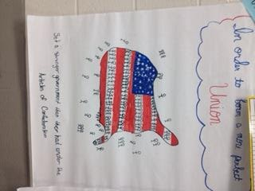

Slide 4
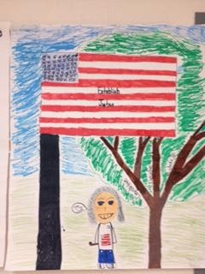
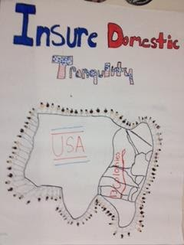

Slide 5
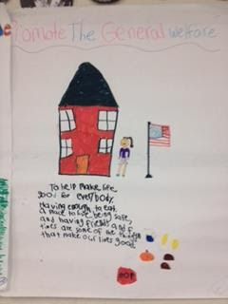
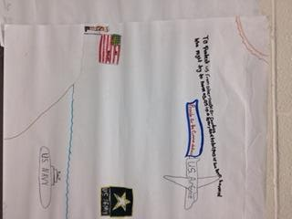

Slide 6
