Slide 1
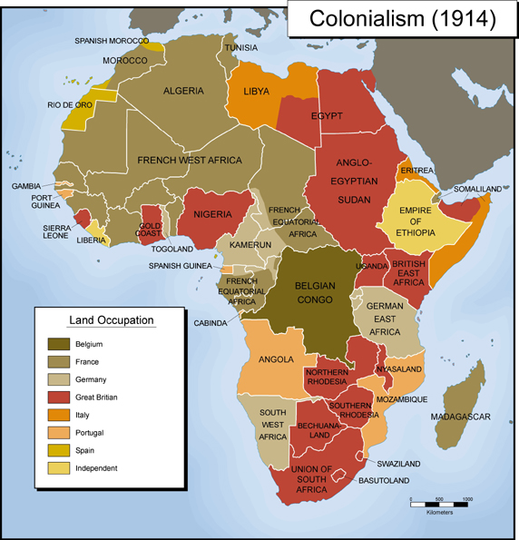
PEBC Research-Based Practice: Engaging Students in Classroom Discourse that Cultivates Understanding
Encouraging thinking, inquiry, and problem-solving through discussion…and auctioning a continent

Slide 2
Levels of Proficiency
(1) Novice: Leads Discussion
(2) Emergent: Models clarifying questions, is aware of the role of discourse in making meaning, creates opportunities for small group or paired discussion to explore ideas and or solve problems.
(3) Proficient: Teaches students to ask clarifying questions, regularly probes student thinking, and encourages students to discuss their thinking with peers and to take risks while learning on a routine basis (thinking is encouraged vs. right or wrong answers)

Slide 3
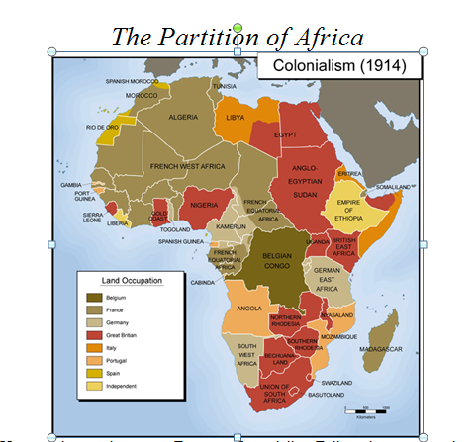
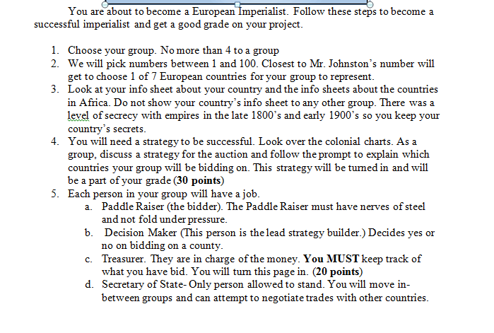
The Assignment

Slide 4
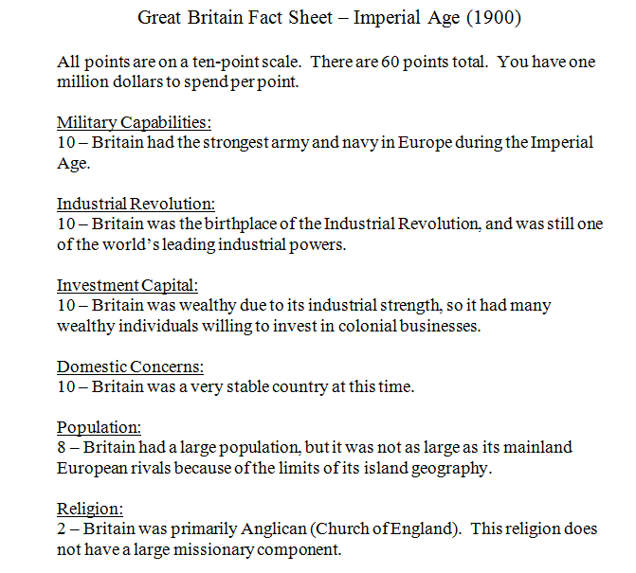
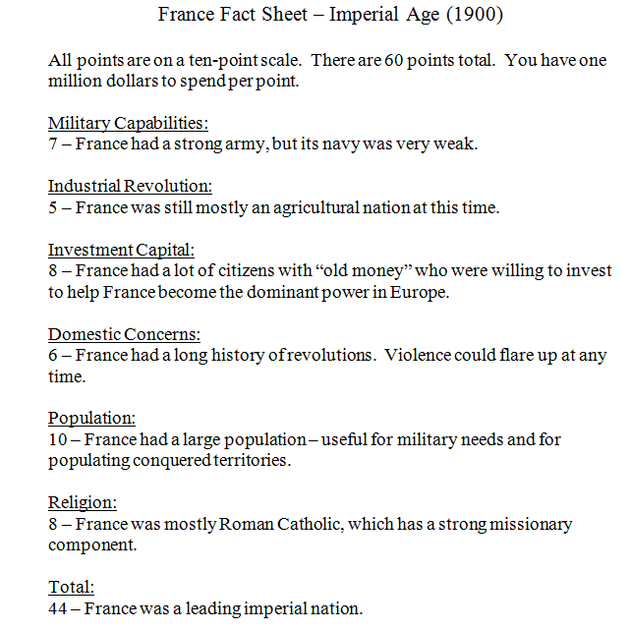

Slide 5
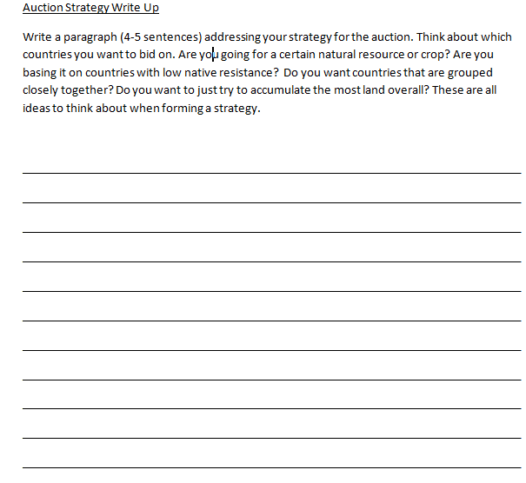
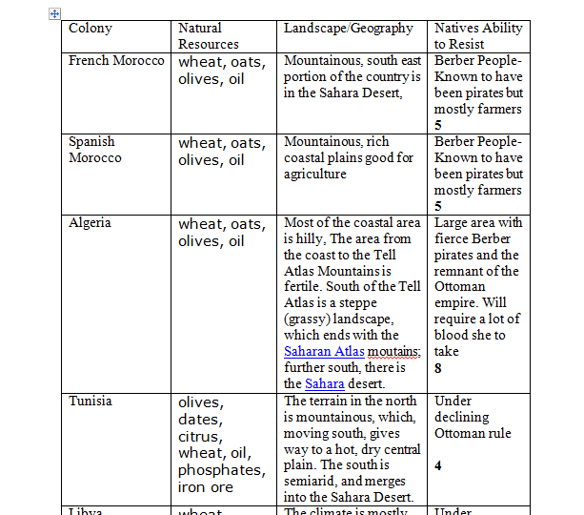

Slide 6
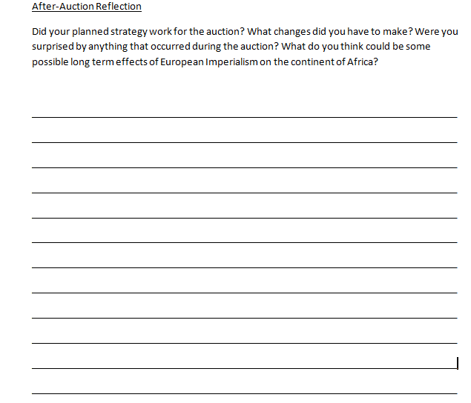
At this stage I show the Atrocities of the Belgian Congo PowerPoint

Slide 7
Benefits I Hope to See
A better understanding of thought process
Helps students construct rational strategies and explanations for these strategies
Engages students with a real-life historical situation
Presents consequences for decisions
Allows students to formulate conclusions

