Slide 1
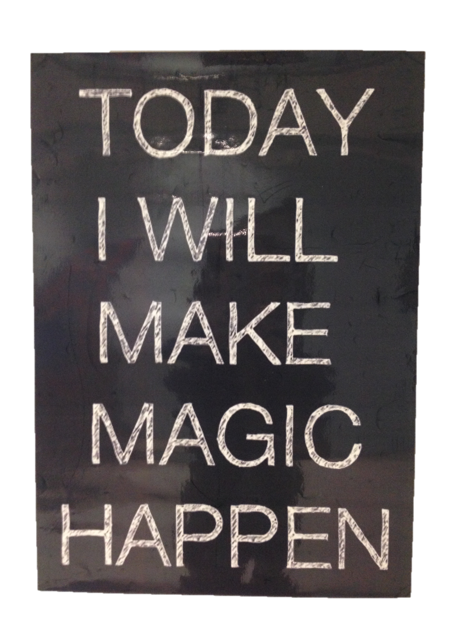
Be
Exemplary

Slide 2
Know Your Students 1B
35%
35%
Mastery Learners
Interpersonal Learners
12%
65%
10%
20%
Understanding Learners
Self-Expressive Learners
1%
22%

Slide 3
Exemplary 1B
Teacher actively seeks knowledge of students’ levels of development and their backgrounds, skills, interests, and special needs from a variety of sources. This information is acquired for individual students. The teacher maintains a system of updated student records and incorporates learning needs into lesson plans.
Domain 1B
Knowledge of
Students
Exemplary 3C
Students suggest modifications to the grouping patterns used. A student asks whether they might remain in their small groups to complete another section of the activity.
Domain 3C

Slide 4
What Puts the “E”
in Exemplary?

Slide 5
Student-Centered Classrooms
“..by listening to teach instead of talking to teach, students should be just as exhausted as teachers at the end of the day – and just as brilliant.”

Slide 6
Develop a Community of Learners
Exemplary 2A & 2B
Students help each other and accept help from each other without teacher prompting. Students hush classmates causing a distraction while the teacher or another student is speaking. Students clap enthusiastically after one another's presentations for a job well done. The teacher conveys high expectations for learning by all students and insists on hard work. Students assume responsibility for high quality by initiating improvements, making revisions, adding detail, and/or helping peers.
Community
Connections
Relationships
Classroom
Looks Like
Sounds Like
Routines

Slide 7
2c Managing Classroom Procedures
The establishment of efficient routines, and success in teaching students to employ them, may be inferred from the sense that the class “runs itself”.
Students as Customers of Instruction
Student-Centered Classrooms
Exemplary
Instructional time is maximized because of efficient routine and procedures. Students contribute to the management of instructional groups, transitions, and the handling of materials and supplies. Routines are well understood and may be initiated by students.
High Expectations
Professional Learning
Assessment for Learning

Slide 8
“It was as if a light
bulb came on when I realized that I was doing most of the talking and
thinking in my classes. I was learning a great wealth of information while my students
touched only the surface”. 7th grade math teacher

Slide 9
“The workshop model of instruction has transformed my classroom. It has been a blessing to my career. It has completely changed the way I teach and now I am striving to be the reading teacher that I always wanted to be all these years”.
3rd grade teacher

Slide 10
“It was time for change, a change that has caused me some very frustrating moments, lots of plan changes and many sleepless nights. However, I’m proud to say I wouldn’t go back to the “good teacher” I thought I was. The learning and thinking I’ve seen take place in my classroom this year has been amazing! It hasn’t been easy for me, but the changes have been worth every struggle and doubt”. 8th grade reading teacher

Slide 11
A lesson in which students are engaged usually has a discernible structure: a beginning, a middle, and an end, with scaffolding provided by the teacher or by the activities themselves.
3c Engaging Students in Learning
Students as Customers of Instruction
Student-Centered Classrooms
The teacher organizes student tasks to provide cognitive challenge and then encourages students to reflect on what they have done and what they have learned. This is, the lesson has closure, in which students derive the important learning from their own actions.
High Expectations
Professional Learning
Assessment for Learning
The best evidence for student engagement is what students are saying and doing as a consequence of what the teacher does, or has done, or has planned.

Slide 12
Why Student Centered?
..typically have both teacher-led and student-centered components, ..The typical sequence is for teacher-led explicit instruction to be followed by a gradual release of responsibility to the students themselves. The studies have shown that students who are taught to use a variety of cognitive and metacognitive strategies have greater gains in metacognitive awareness and academic achievement than students who do not receive the training.
Hattie & Anderman 2013

Slide 13
Workshop
Debrief –
Reflection
Minilesson
Exemplary
Practice
Student
Work Time

Slide 14
Direct Instruction – Mini-lesson
Scaffold
Connect
Hook
Define
Purpose
Model
Exemplary 3A
The teacher links the instructional purpose of the lesson to the students’ interests; the directions and procedures are clear and anticipate possible student misunderstanding. The teacher’s explanation of content is thorough and clear, developing conceptual understanding through artful scaffolding and connecting with students’ interest.

Slide 15
Release to
Grapple
Partners/
Groups
Student
Work time
Promote
Discourse
Rigorous
Task
Exemplary 3B
Teacher uses a variety or series of questions or prompts to challenge students cognitively, advance high-level thinking and discourse, and promote metacognition. Students formulate many questions, initiate topics, and make unsolicited contributions.
Exemplary 3C
Virtually all students are intellectually engaged in challenging content through well-designed learning tasks and suitable scaffolding by the teacher.. In addition, there is evidence of some student initiation of inquiry and of student contribution to the exploration of important content. Students may have some choice in how they complete tasks and may serve as resources for one another.

Slide 16
Exemplary 3D
Assessment is fully integrated into instruction through extensive use of formative assessment. Questions, prompts, assessments are used regularly to diagnose evidence of learning by individual students. Teacher monitoring of student understanding is sophisticated and continuous: the teacher is constantly “taking the pulse” of the class. Feedback to students is specific and timely, and is provided from many sources including other students. While students are working, the teacher circulates, providing substantive feedback to individual students.
Teacher Moves
Feedback/
Questions
Student
Work Time
Assessing
Planning
Conferring

Slide 17
Debrief-
Reflection
Synthesis
Self-Assess
Share
Thinking
Connections
Exemplary 3C
Students summarize their learning from the lesson. Students have the opportunity for both reflection and closure after the lesson to consolidate their understanding.
Exemplary 3D
Students self-assess and monitor their progress. A variety of feedback, from both their teacher and their peers, is accurate, specific, and advances learning. The teacher uses exit tickets to elicit evidence of individual student understanding. Students offer feedback to their classmates on their work.

Slide 18
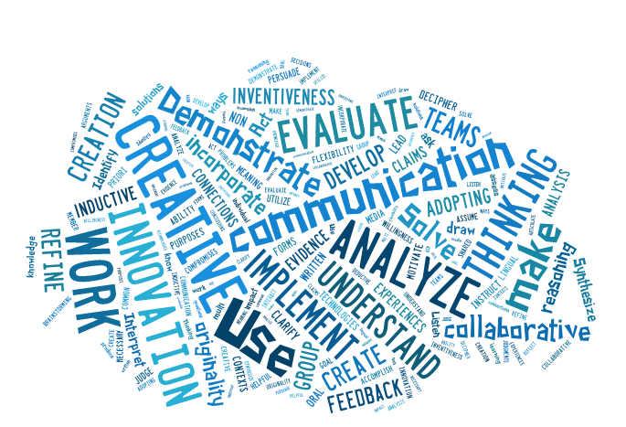
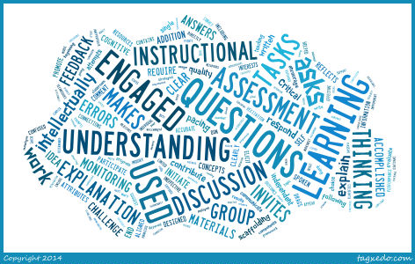
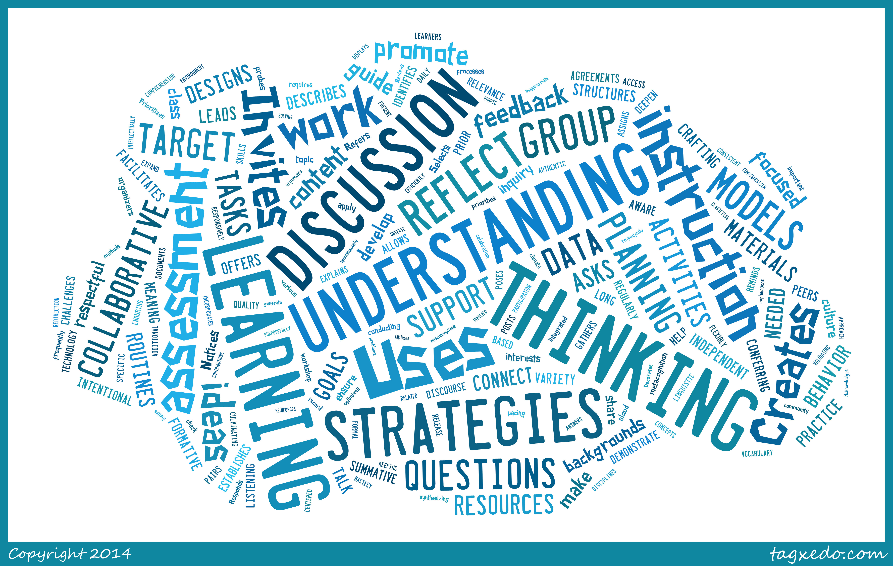
The skill connections
Danielson Domain 3
21st Century Learning Skills
Workshop & Thinking Strategies

Slide 19
It’s Morning Again
Thank You!!
Rick Fisher – Allen County Schools
ricky.fisher@allen.kyschools.us
www.allen.kyschools.us/

