Slide 1
Continuum of Growth: Applying Thinking Strategies Across Content to Deepen Understanding
5th Grade/ELA -Cheryl Miller

Slide 2
Teaching TS to build understanding ​
Frequently model in-depth use of the thinking strategies during direct instruction and conferring after students reflect on their DSA (daily self-assessment

Slide 3
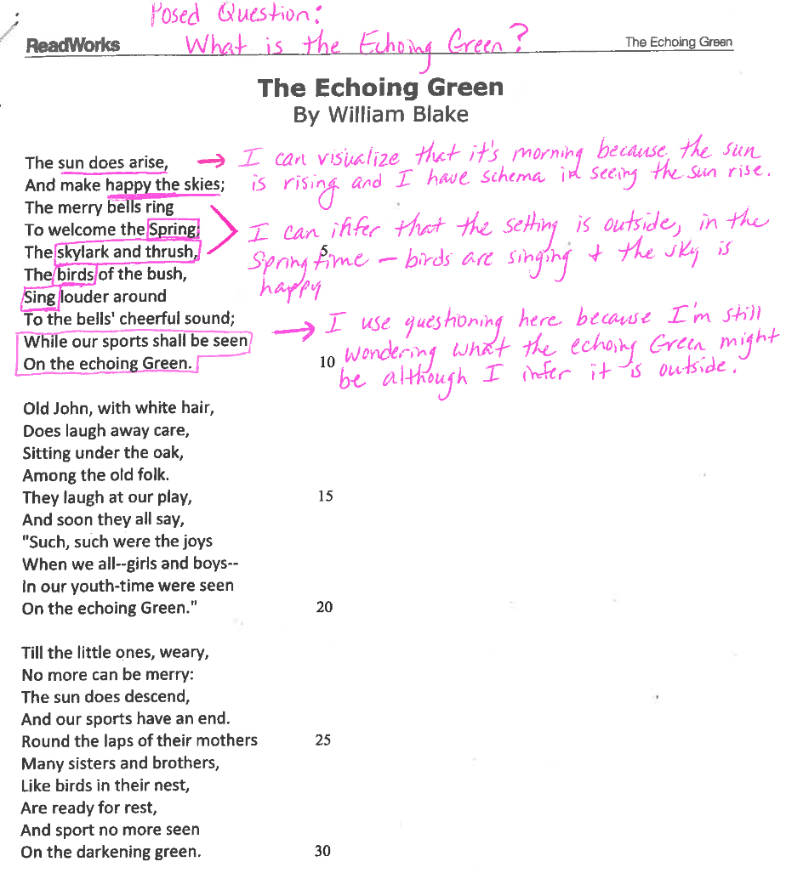

Slide 4
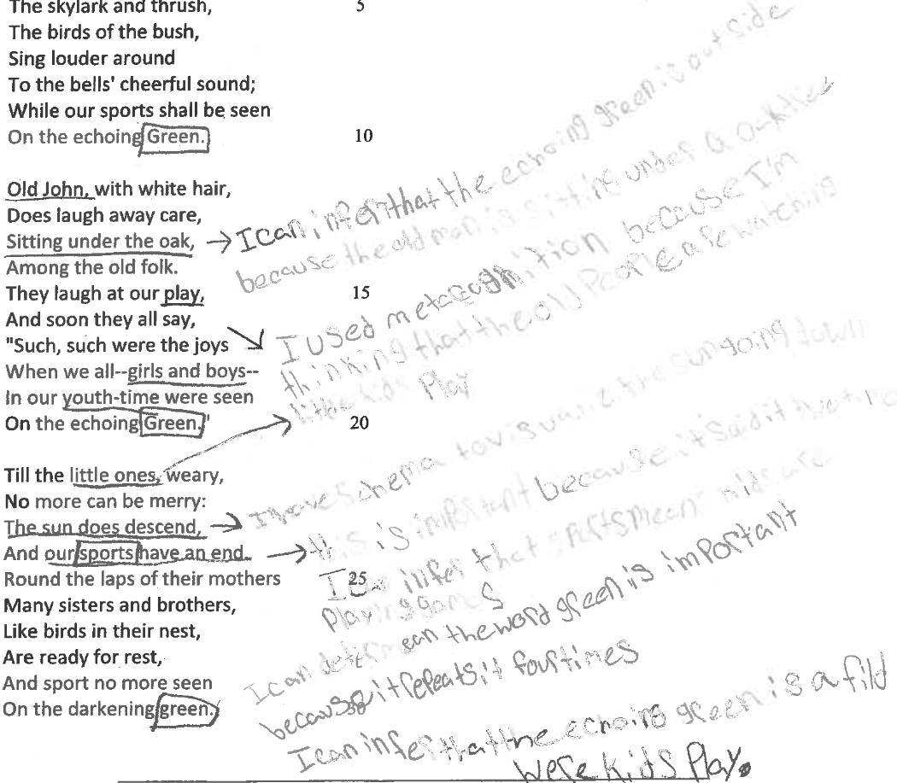

Slide 5
