Slide 1
Office 365

Slide 2
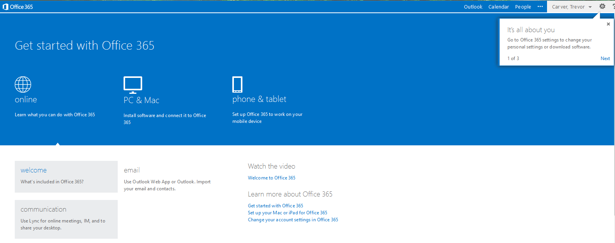
Once you log in, you will need to click the Outlook tab to go to email
Logging into Office 365

Slide 3
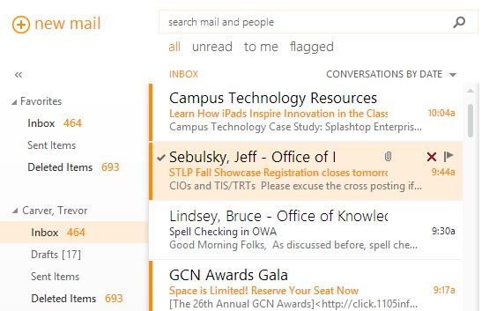
Once inside Outlook, look to the top left and select new mail in order to create an email message.

Slide 4
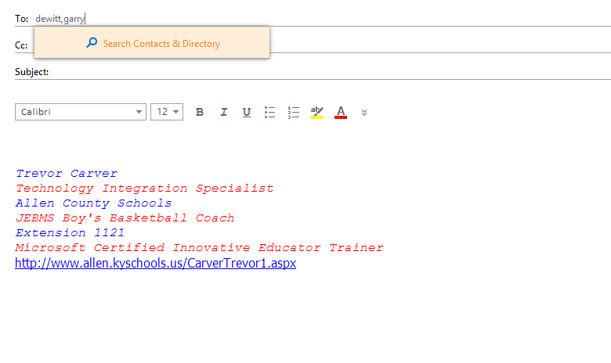
When you begin to type a colleague’s name, you may not see their name pop up due to the Office 365 migration. (Over time, it will begin to remember.)

Slide 5
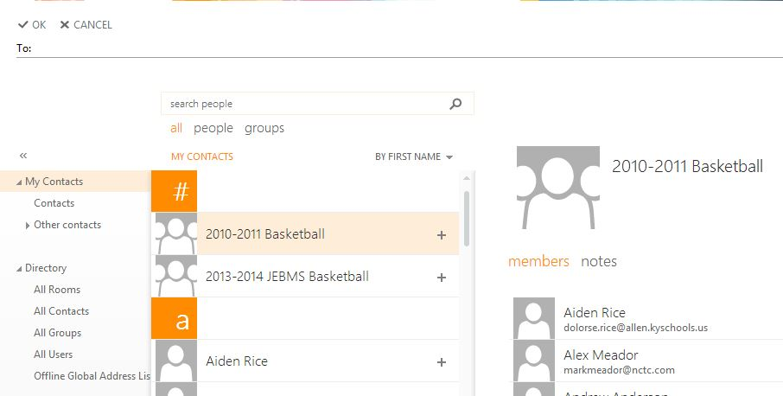
If you select “To”, you will see the screen below. Immediately, your contacts will appear. But, if you will type the recipient’s name and the search tool, all recipients will appear (not just your contacts).

Slide 6
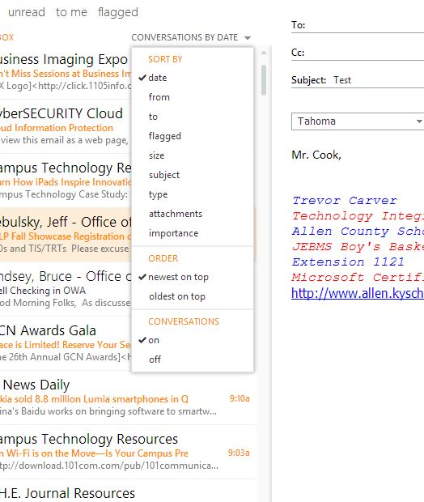
Turn off conversations
If you want to see all emails, and they not be grouped, click conversations by date. Then look to bottom and in the section label, conversations, change to OFF. Now, all emails will be shown in your inbox.

Slide 7
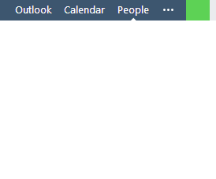
People
When clicking on People, in the upper right hand corner, that takes you to your contacts and the directory. When doing so, you can also click new mail in order to email as well.

