Slide 1
Is there an app for that???
Weaving Technology into Your Elementary Music Class
Presented by:
Julie Hartman
Allen County Primary Center

Slide 2
Where are you at, technically speaking?
Do you try to die when they tell you the internet is down for the day?
Do you have technology in your classroom you can’t live without?
Do you depend on your personal children to solve your tech problems?

Slide 3
My TECHIE kiddos!

Slide 4
Allen County Schools Technology Survey
We surveyed 577 2nd-5th graders at Allen County Primary and Allen County Intermediate.
We are a VERY rural district with a little over 60% free and reduced lunch.

Slide 5
Here’s what we discovered:
80% of students surveyed have a computer at home.
70% have internet access.
55% use a computer to listen to music.
35% use iTunes to manipulate music.
90% have a gaming device.

Slide 6
67% have a personal listening device.
65% have a touch device.
65% use or own a cell phone.
Are you surprised?

Slide 7
What’s our goal????
To provide you with technology ideas you can take back to your classroom and use, some on Monday morning!

Slide 8
So…what do I have in my classroom?
ENO board (Interactive Whiteboard)
My computer and 5 student computer station
Piano
Keyboards
Music in Education lab
iPod Touch, 2 iPads, and a docking station

Slide 9
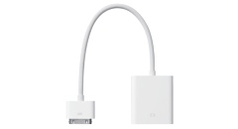
Whole Group Instruction:
If you have one of these,
then you can project an iPad onto an IWB!

Slide 10
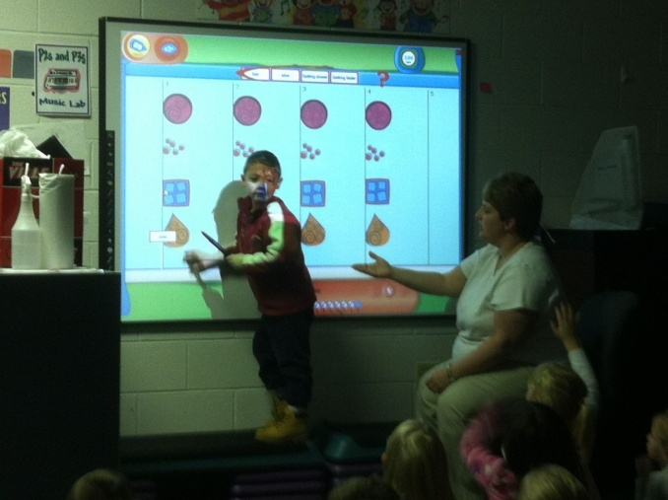
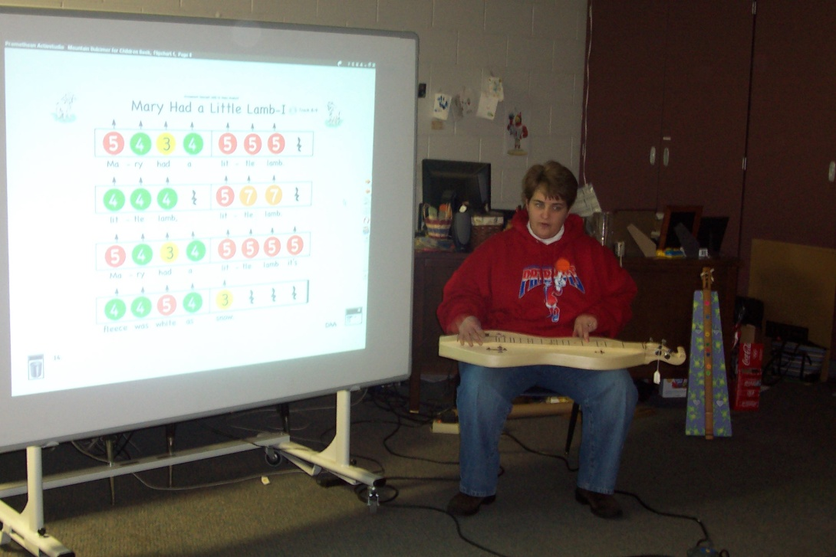
Do you have an IWB? Do you USE it?

Slide 11
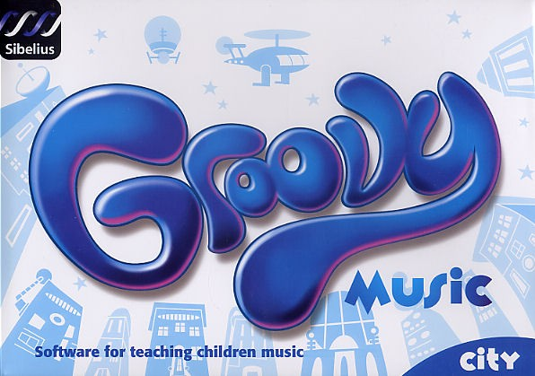
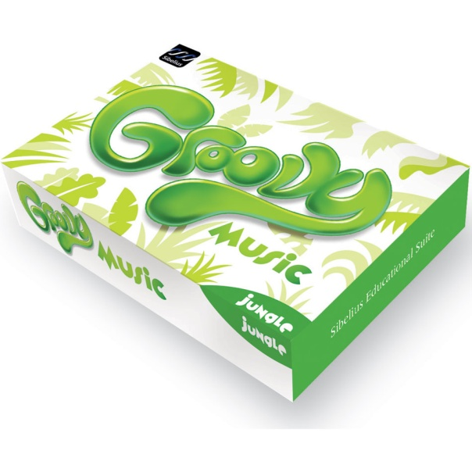
MY FAVORITE PROGRAM IS…

Slide 12
Do you use Quaver?
Wonderful DVD program with awesome activities on the website.
This program really keeps the kids engaged!
Well worth the money!

Slide 13
Other Websites to interest you…
BrainPop Jr. and BrainPop
Pinterest (YES…PINTEREST!)
www.theteachersguide.com
Web20guru.wikispaces.com
Discovery Education
fur.ly
www.balldroppings.com/js
fotoflexer.com

Slide 14
Songsmith
Microsoft product
Free download
http://www.pil-network.com/
Simple recording tool: Microsoft’s answer to Garage Band
Simple voice recording, or add other tracks to it.
The difference? Garage Band allows you to record multiple tracks…Songsmith, one, then layer with pre-recorded tracks
A better fit for K-5 students?

Slide 15
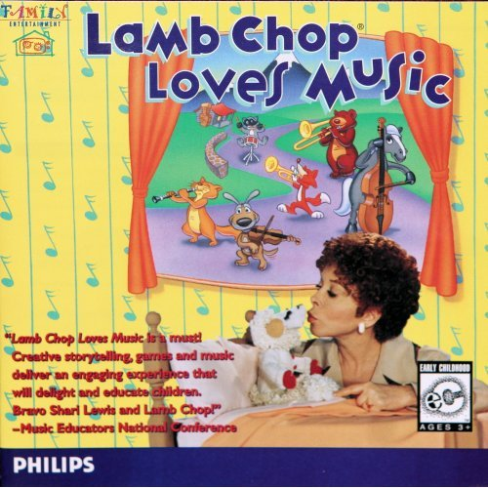
Another Software Fave
Lamb Chop Loves Music

Slide 16
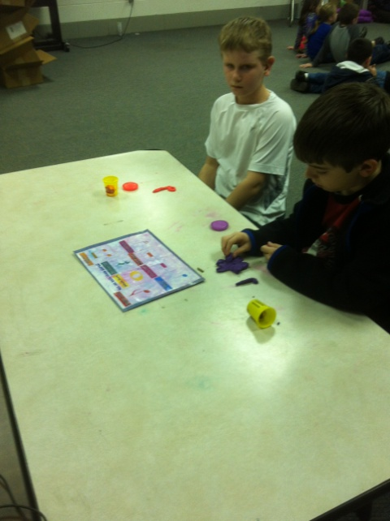
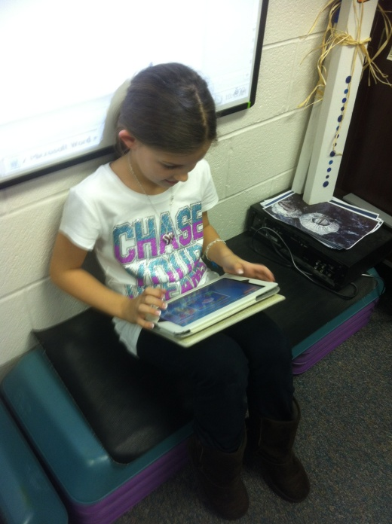
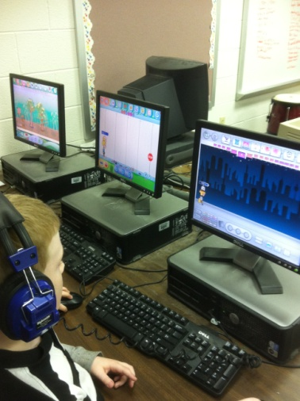
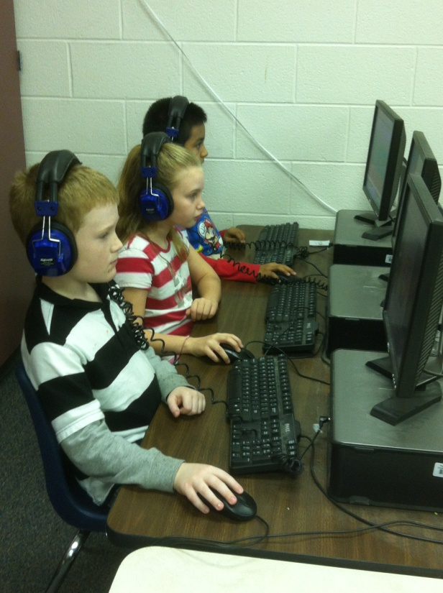
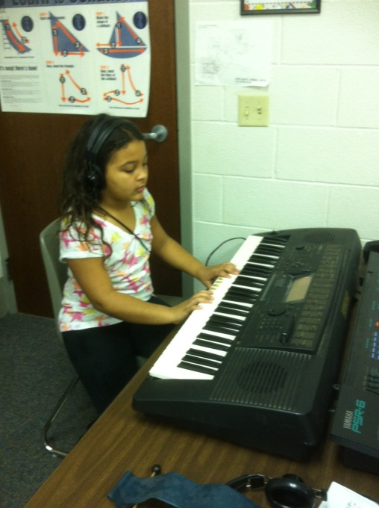
Have you ever used centers??

Slide 17
Using your iPad
Are you a 1:1 iPad school? Maybe some of these apps will work for you, particularly the creating apps!
Just have a personal iPad? Use it whole class with your IWB!
Only have one iPad for the students to use? CENTERS!
Many apps are ok for iPod Touch, as well.

Slide 18
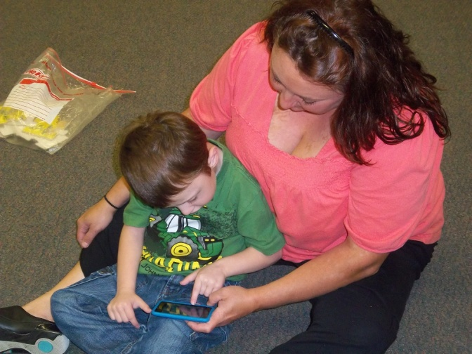
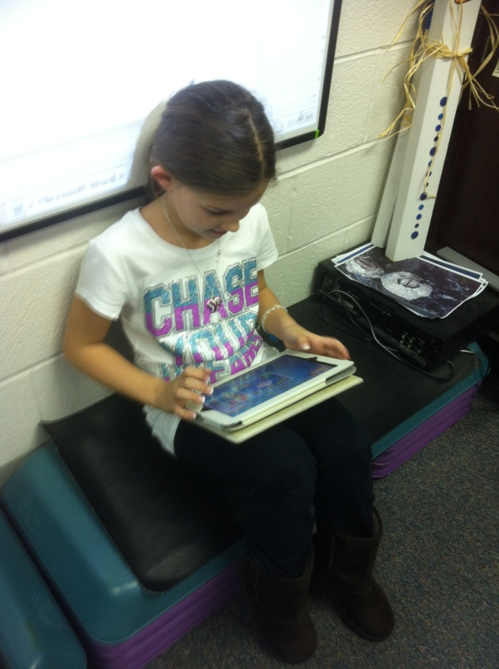
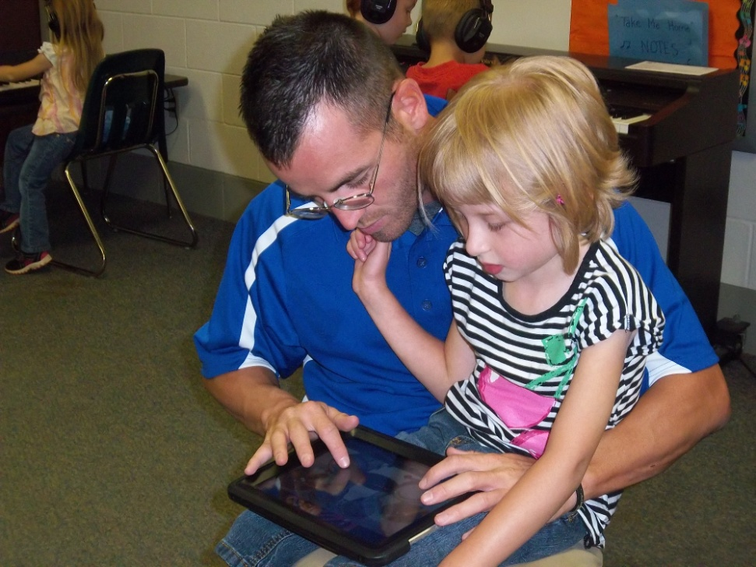
Many Uses for iPads in the Classroom:

Slide 19
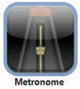
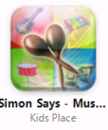
Top Ten Music Apps
#10…
#9…
#8…

Slide 20
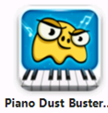
#7…
#6…
#5…

Slide 21
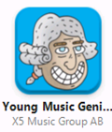
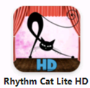
#4…
#3…
#2…

Slide 22
And my #1 fave music app is…

Slide 23
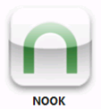
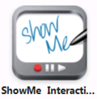
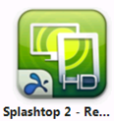
Apps to “help” you…

Slide 24
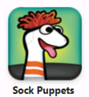
More helpful apps…

Slide 25
Overwhelmed?????
CONTACT ME!
I am HAPPY to help!
julie.hartman@allen.kyschools.us
Julie Tinsley Hartman

