Slide 1
Intentional “Safe” Science Journals
The safe journals are not for me….they are for the student. I do not use them as an assessment, but I do scan them as a formative measure.
I find students feel more free to write if their ideas are not being judged or graded and if they are not afraid they will be marked down for their mistakes.
I also see them grab on to the idea that it is their own personal resource tool.

Slide 2
What I Intend…
Capture the goals and beginning thoughts.
Used throughout class to capture important ideas.
Where we capture what we do (data, vocal, discussion, etc)
Where we reflect and capture where we ended the day.
What my students know…
Not collected for grade.
Used to drive teacher student discussions.
No one way to capture ideas (write/draw/etc.)
Should be Students a chronological record of class.

Slide 3
What I Intend…
Capture the goals and beginning thoughts.
Used throughout class to capture important ideas.
Where we capture what we do (data, vocal, discussion, etc)
Where we reflect and capture where we ended the day.
What my students know…
Not collected for grade.
Used to drive teacher student discussions.
No one way to capture ideas (write/draw/etc.)
Should be Students a chronological record of class.

Slide 4
What does a grade say?
How do you explain the difference between a
92 and a 96… a 87 and 89…a 75 and a 77?
How about a 88 and 91 (A whole letter grade) when both are above average and show a student gets it?
When a summative is taken, and they make 78%, what part of the 22% missed tell about the students understanding about which target/standard?
Did they miss a couple in each target OR just really not understand one target out of the five?

Slide 5
Target Mastery Grading
I believe the goal of my assessment (formative or summative) should be to tell me (student and parent)
if a student gets it, kinds of gets it, or doesn't get it.
Level 3 (Mastered):
Has it…gets it…evidence shows they know it.
Level 2 (Still in Progress):
Kind of has it…is making some mistakes, shows some basic understanding, but evidence shows they need some help/practice.
Level 1 (Far From It):
Doesn’t get it…evidence shows they needs me to intervene.

Slide 6
Target Mastery Grading (practice/formative/summative)
Mastery Level Achieved
3 You Got It! | 2 You “Kind of” Got It | 1 You Don’t Got It
Mastered | Progressing Toward Mastering | Far From Mastered
Complete | Mostly Complete | Very Incomplete
Well Supported | Offers Some Support | Lacks Support
80% or more accurate | 79-61% Accurate | Below 60% accuracy
Performs without error | Performs with minor error | Can not perform
High Quality Product (planning evident, very neat, etc.) | Solid Quality Product (some planning evident, somewhat neat, etc) | Poor Quality Product (no planning evident, messy, etc.
High level of effort reflected | Effort reflected | Lacks evidence of effort
Ready to move on! | Can move on! | Stop and relearn
Extended Learning | CAN do a relearn and reassess if you so choose. | MUST do a relearn activity and attempt a reassessment.

Slide 7
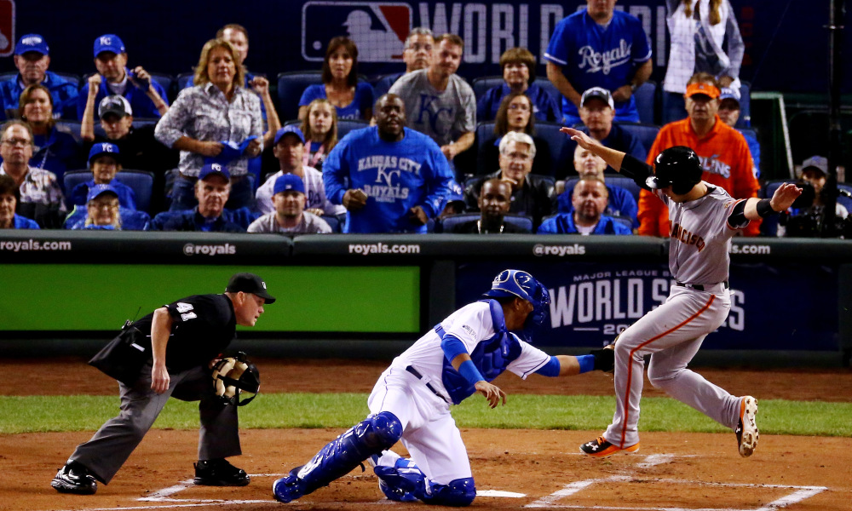
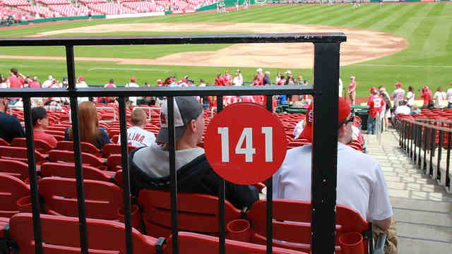
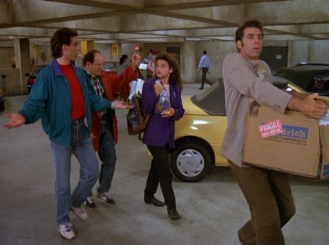
In Kid Terms
At the game.
Parked and
through the gate.
In your seat with
refreshments.
At the game.
Parked and
through the gate.
Still looking for
your seat.
Still in the
parking lot
looking for you
seat.

Slide 8
I teach based on targets and standards.
I create lessons to practice that target/standard.
I give formative to track progress of targets/standards.
I want my assessment to help me judge mastery of a target/standard.
My Practices/Formatives
Rubric Based and give a 3, 2, 1 with feedback
My Finals Unit Assessments
Broken into targets.
Enough questions/task for me to feel I can make a judgement on level of mastery.
I record target grades (not a single test grade).

Slide 9
Summative Final Example:
My Test is over 5 unit targets
(I had 10 focused questions for each target for a total of 50 question) .
Student took the test and scored a 74% total “C”
Target Measured | Number missed out of 10 | Percent | Level of Mastery
Target 1 | 0 | 100 | 3
Target 2 | 0 | 100 | 3
Target 3 | 1 | 90 | 3
Target 4 | 2 | 80 | 2.5*
Target 5 | 8 | 20 | 1
Overall | 13 74% Grade | Only 1 target was low. | 2.5 = 83% Mastery
What was evident in terms of what the student mastered
was better than the number they scored and
I can see/credit that to the student.

Slide 10
Infinite Campus
In my I.C. you will see 3s, 2s, or 1s for
each measured target or task.
I did make one adjustment.
At the cut off (the close but) scores
Between a 3 and 2 is my 2.5
Between my 2 and 1 is my 1.5
I teach based on targets and standards.
I create lessons to practice that target/standard.
I give formative to track progress of targets/standards.
I want my assessment to help me judge mastery of a target/standard.

