Slide 1
Work Shopping the Argument
Kadi Sue Burden
AC-SHS ENG 10

Slide 2
Identifies when to build on students’ existing background knowledge and when additional instruction is required.
Designs tasks with authentic purposes and audiences and various ways for students to demonstrate understanding.
PEBC CONTINUUM OF GROWTH IN BEST INSTRUCTIONAL PRACTICES

Slide 3
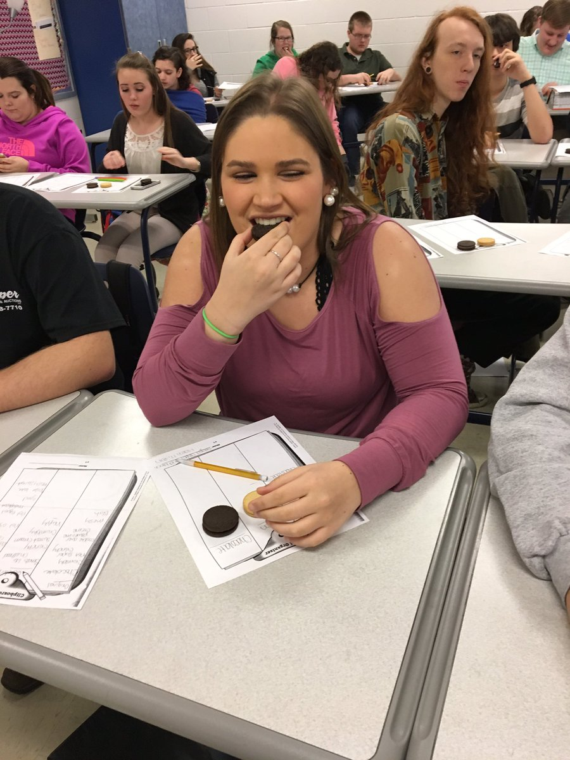
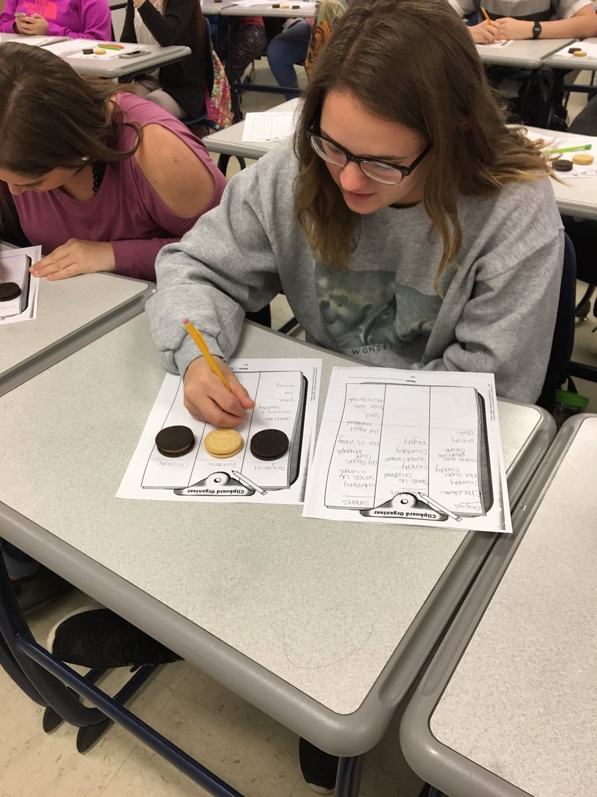
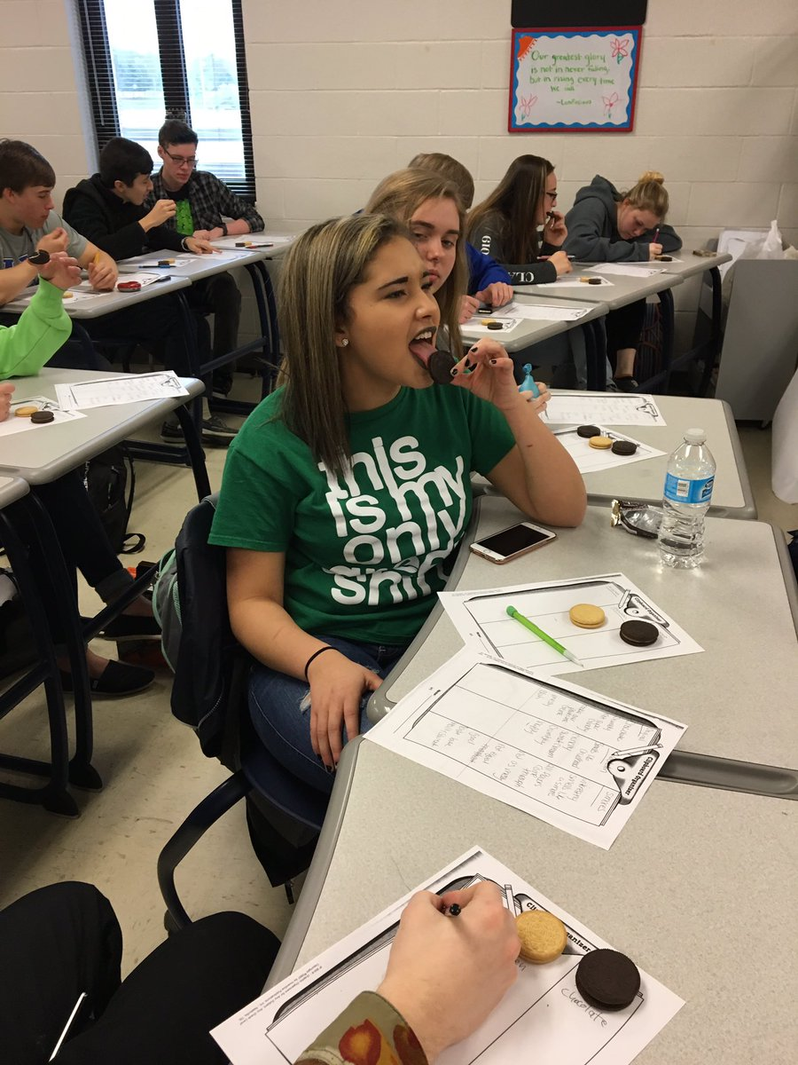
Hooking & Pre Assessing!
PROVE IT!
Which Oreo is the best?

Slide 4
Workshop Model
Mini Lesson
Student Work Time
Model
Reflection
Check in

Slide 5
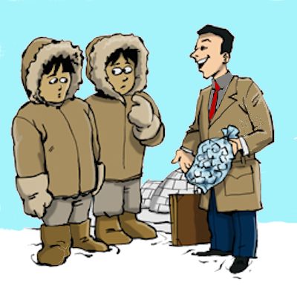
Claims
Selling Ice to an Eskimo
Objects: 1/2 roll of masking tape, pink construction paper, dead houseplant, empty water bottle, bent paper clip
Groups: Accordion Players of Florida, Deep Sea Adventures of Iowa, The League of Polka Dancers

Slide 6
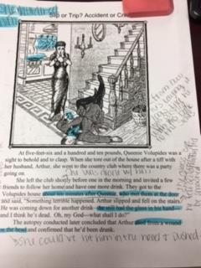
evidence
Slip or Trip?
Accident or Crime?
1) Make a claim
2) Use the information (text & picture) to find evidence to support the claim.
3) Think-Pair-Share
4) 4 Corner Debate

Slide 7
Warrants
Model:
Claim: Fifth graders like sports more than any other activity.
Evidence: A survey showed that 22% of all students at Conrad Elementary School identify sports as their favorite activity.Warrant: Due to the fact that 22% was the highest percentage named for any activity it is therefore the students’ favorite.
Student Work time:
Claim: When healthy choices are available along with junk food, students [will / will not] tend to select the healthy options.
Evidence: On a typical day at River Grove High School, the lunch featured grilled chicken breasts, rice, steamed broccoli, and a fruit cup of fresh watermelon cubes. The cafeteria reported that 819 out 1120 students purchased this lunch selection
Warrant:

Slide 8
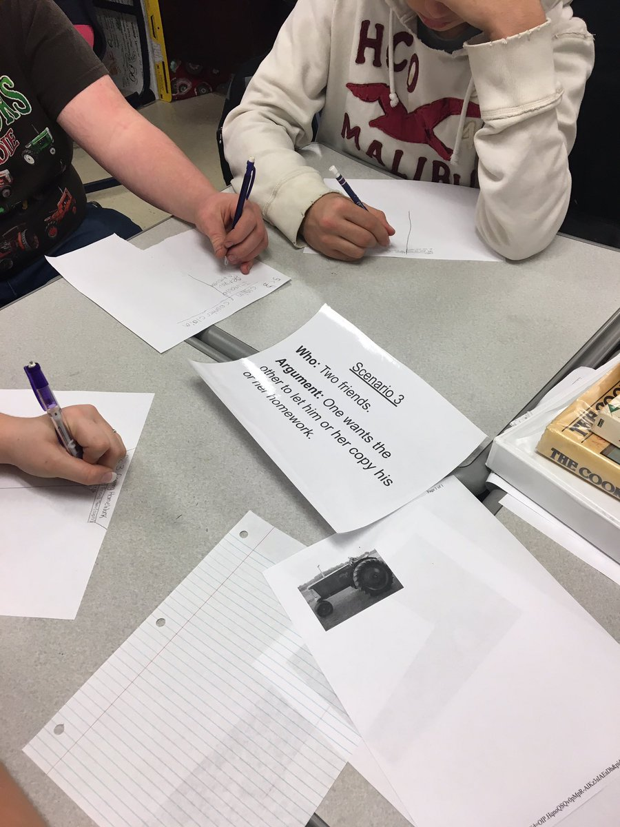
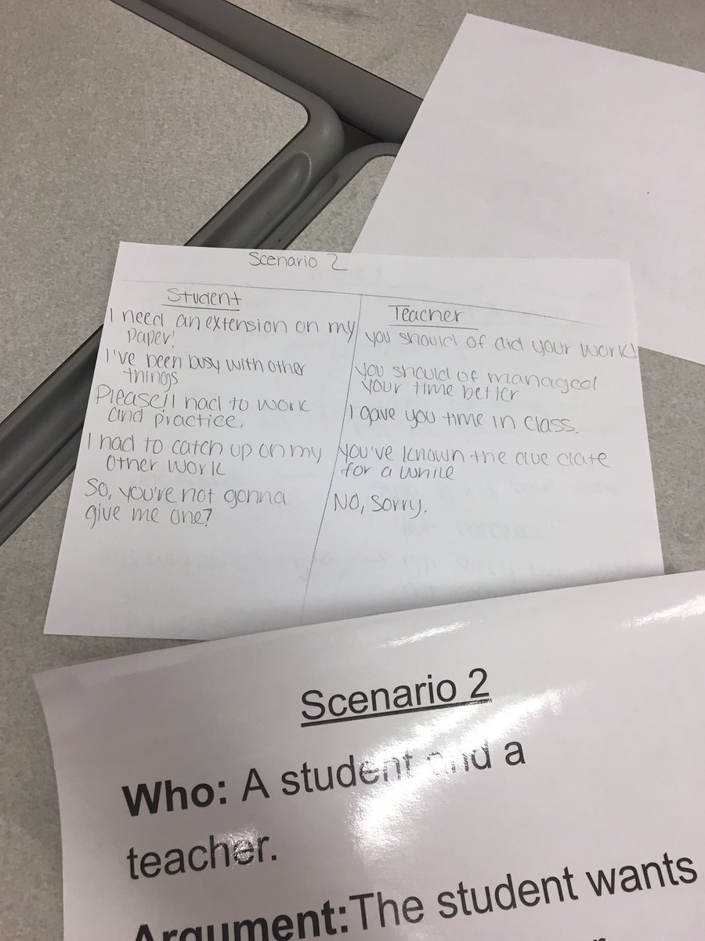
Counterclaims
Tug of War
Real Life Scenarios

Slide 9
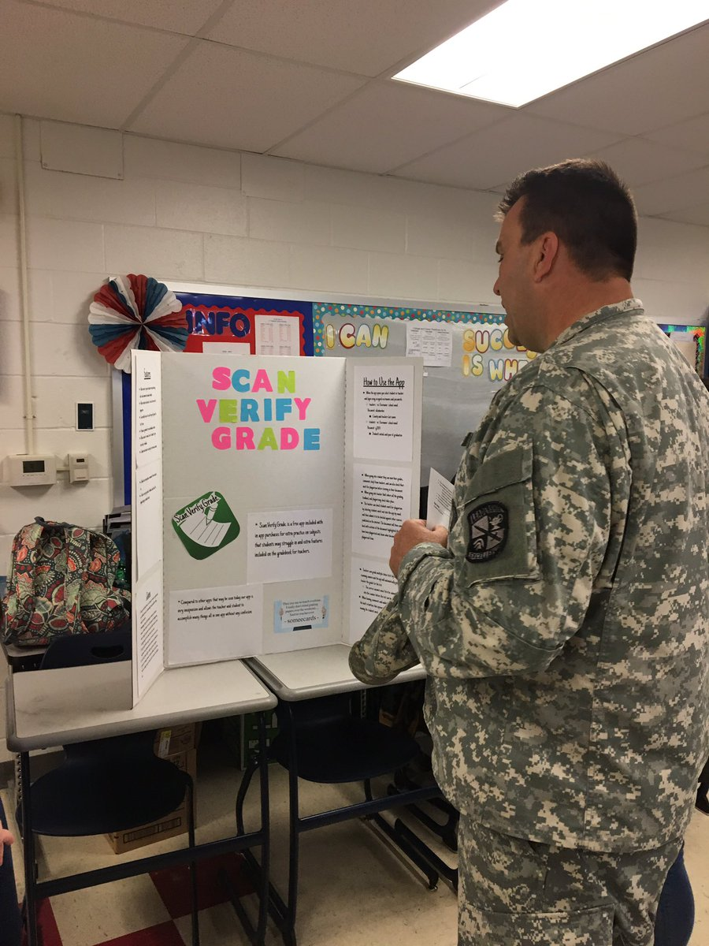
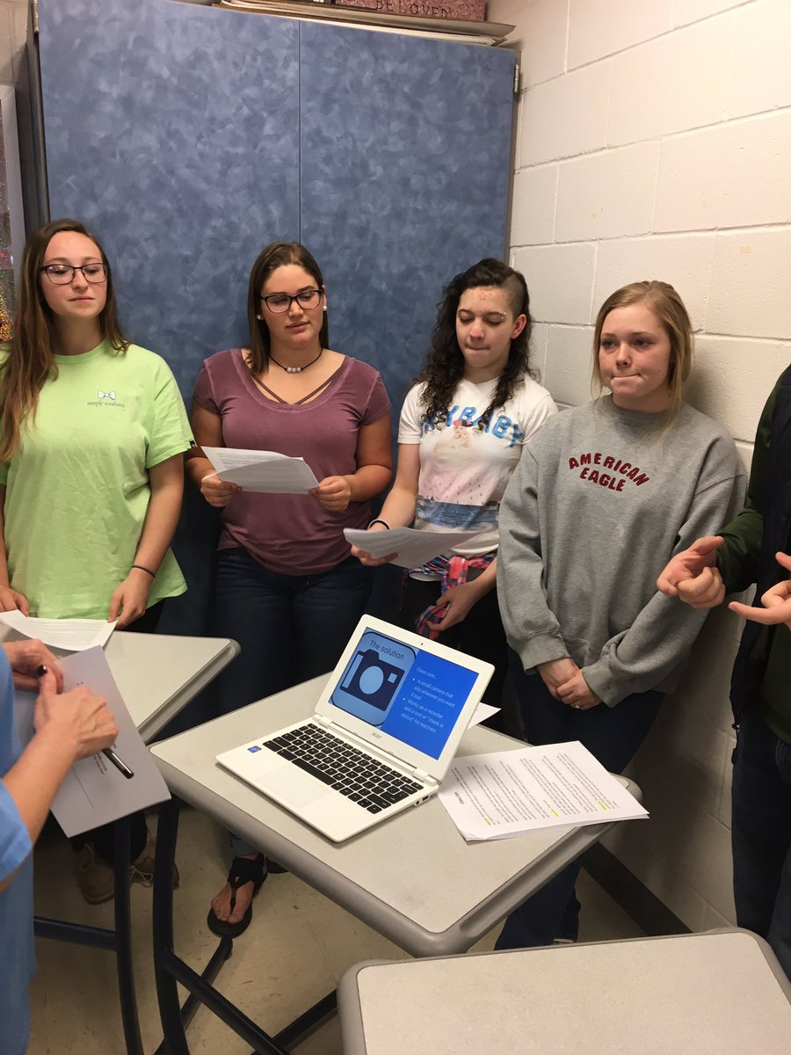
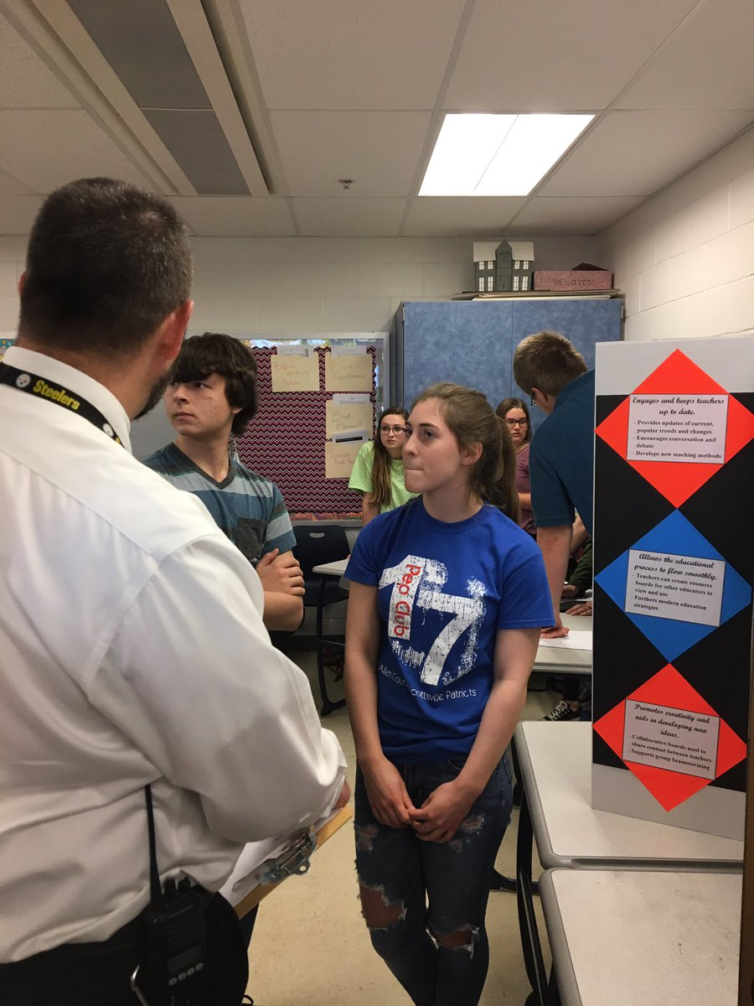
Real World Argument - Invent an App!!

Slide 10
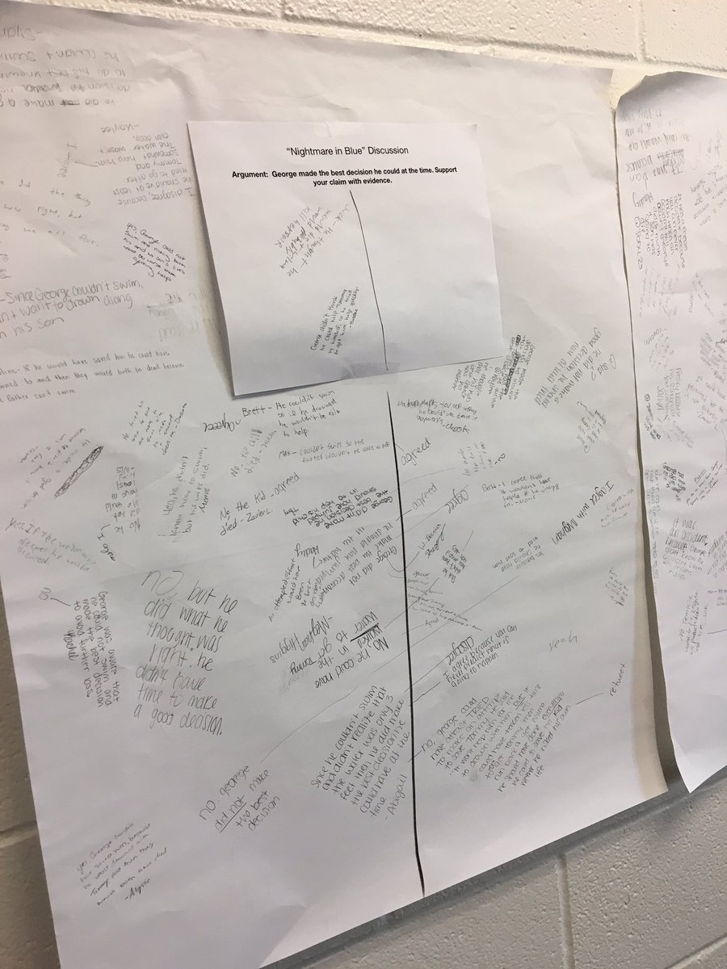
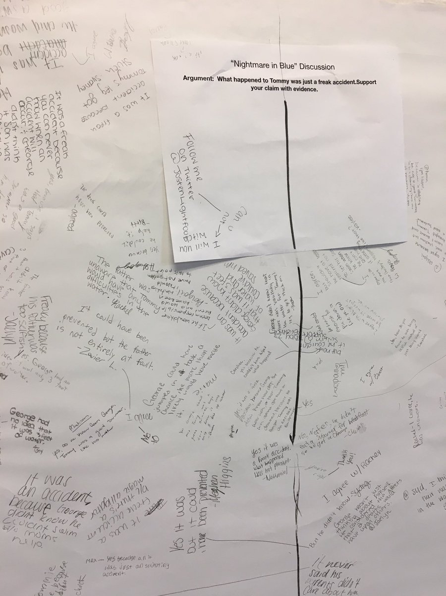
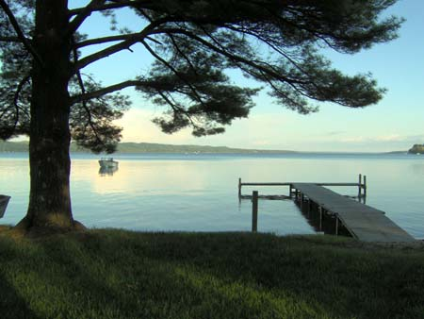
Real World Argument - Is he Guilty???
Answer and Respond
Silent Discussion
NIghtmare in Blue
By Frederic Brown
(Narrative text)

Slide 11
Real World Argument - Is he Guilty?
Writing Prompt: Should George be charged with a crime? Support your answer with textual evidence.
Students were given additional informational articles that explained the degrees of manslaughter and how stress affects decision making to help support their answer.
Students were given an argument outline and a rubric to grade themselves as they wrote.

