Slide 1
Engaging Students in Classroom Discourse that Cultivates Understanding
Reading Like a Historian
Evaluating Political Cartoons

Slide 2
Steps to Analyzing a Political Cartoon:
List the parts of the political cartoon and the importance of each part (what is happening?)
Describe the focus or significance of the political cartoon (why was the picture drawn?)
Explain what the artist is trying to say (point of view)
Make a connection between the cartoon and what I am studying

Slide 3
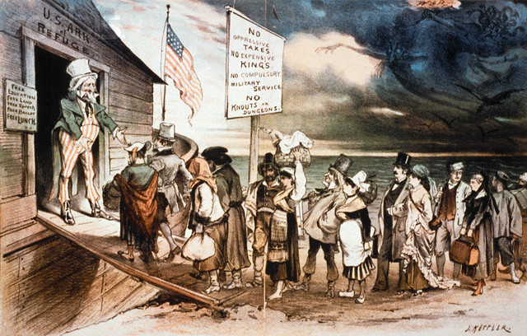

Slide 4
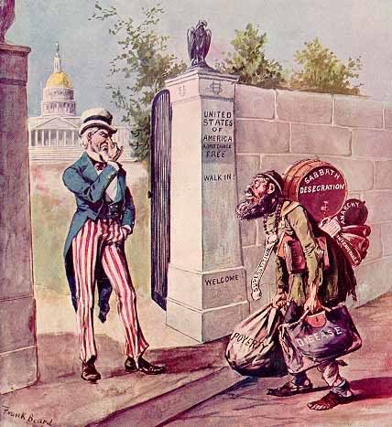

Slide 5
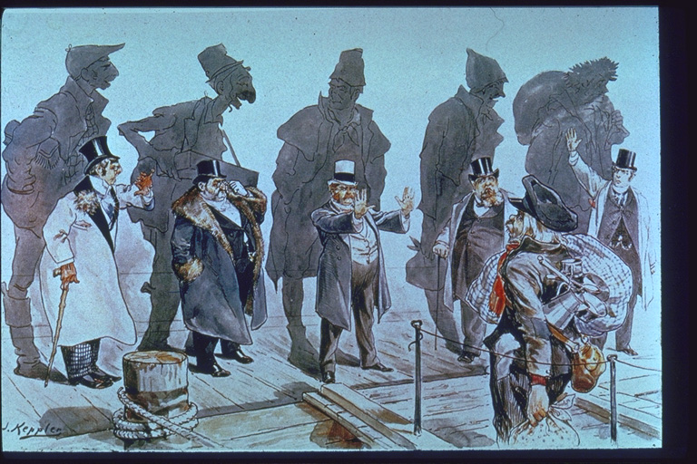

Slide 6
Benefits
Helps students evaluate and use sources
Helps students develop claims and use evidence
Helps students see different perspectives on different historical topics
Helps engage students in meaningful discourse

