Slide 1
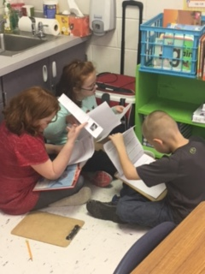
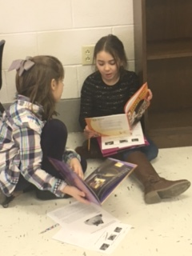
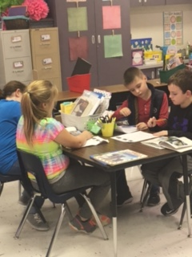
Meaningful Discourse that Cultivates Understanding
Talking with my partner helps me understand the text. ~ Makenna
You get to hear what the other person is thinking. ~ Tyler T.
Pilot Teacher Training
ACPC
2016-2017

Slide 2
In the beginning…
I understood the components of the reading workshop model.
But, I knew an area I needed to work on was engaging students in classroom discourse that cultivated their learning.
I would have considered myself in the emergent level of proficiency on the PEBC Continuum of Growth.

Slide 3
Just let it go…
Control freak? Maybe…
I had to learn to step back and let the students take control over their own learning, including discourse.
At first, I focused on just listening and not talking.
When I conferred with small groups I would tell them that I was just there to listen. I would only intervene if I needed to clear up a misconception.
I’m not going to lie, it was hard for me at first.

Slide 4
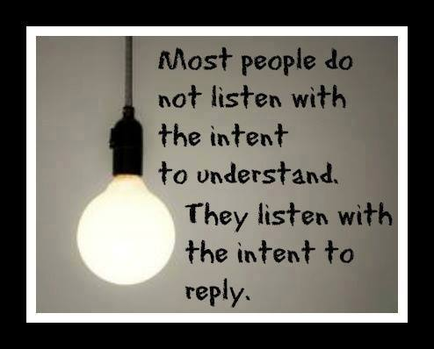
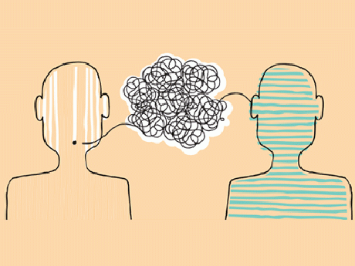
Now…
I had to teach my students how to have a meaningful conversation with each other.
I was intentional with the words I used so they would know exactly how to carry on the conversation.

Slide 5
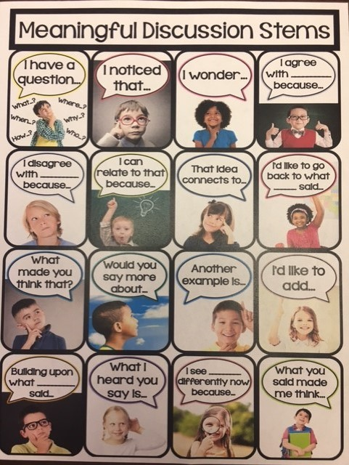
How did I do it…
I made sure I modeled
discussion stems before
expecting them to just do
it on their own. Here are
the meaningful discussion
stems I used.

Slide 6
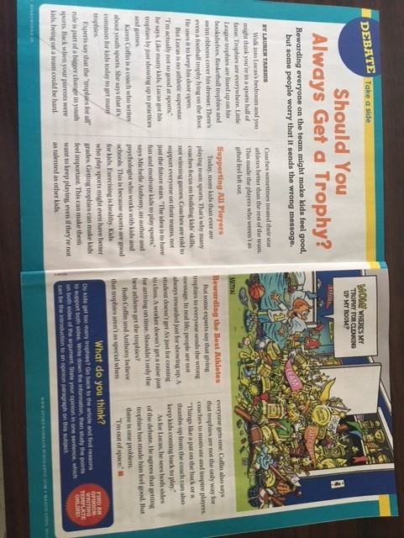
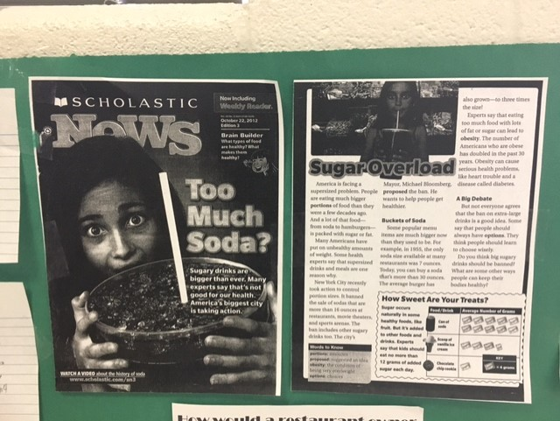
Next…
I made sure that my students had engaging text, something they could actually discuss…text that would challenge the quality of each other’s reasoning.

Slide 7
Engaging/rigorous text requires the students to…
take risks while learning
formulate their own thinking and support it – it’s not a right vs wrong
construct their own explanations and present an argument
provide evidence for their own claims
test their own understanding
reflect on how their thinking may have changed

Slide 8
Thoughts From Students on Meaningful Discourse…
It helps me because I have my thinking and my partner has their own thinking – we can put it together and extend our thinking. ~ Chance
My partner gives me information to think about and helps me understand. ~ Karlie
Partners have different thinking. They can give me new information and make me think more about the text. ~ Keaton
If you don’t‘ know the answer your partner can share their thinking with you to help. ~ India

Slide 9
I’m still trying to figure out…
How to help my students hold on to their thinking to remember and reuse it
I would like to improve this component by showing my students multiple ways to hold on to their thinking beyond sticky notes…double column journals, graphic organizers, etc.
Help students hold on to their thinking with coding when annotating – for example:
TS – text to self D - discuss
TT text to text RS – want to research more
Huh? – confused * - important part
I - inference

