Slide 1
Math Narratives
Rachel Davis

Slide 2
Interpreting Distance-Time Graphs http://map.mathshell.org/
Mathematical Practices
MP1:Make sense of problems and persevere in solving them
MP2:Reason abstractly and quantitatively
MP3:Construct viable arguments and critique the reasoning of others
MP4:Model with mathematics
MP5:Use appropriate tools strategically
MP6:Attend to precision
MP7:Look for and make use of structure
MP8:Look for and express regularity in repeated reasoning
Content Standards
8.F
Define, evaluate, compare functions
Use functions to model relationships between quantities

Slide 3
Introduction Slide
Students chose which narrative matched graph and wrote answer and reasoning on a sheet of paper. Students then rotated from group to group to compare their answers with other groups.
When students returned to desks, they could change their answer, or keep their answer.
Group discussion then took place over answers.

Slide 4
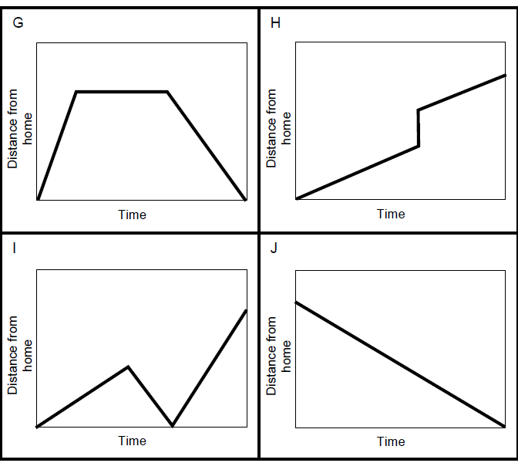
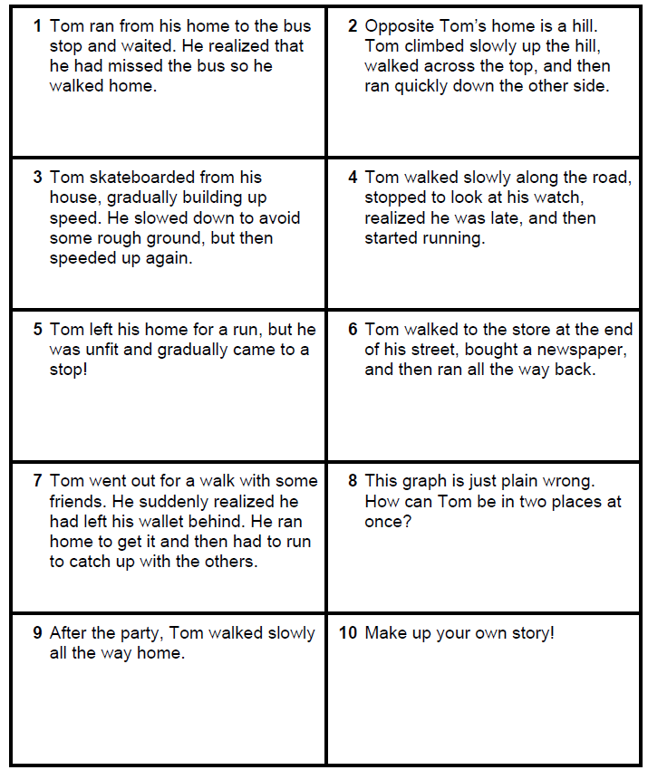
Group Card Sets

Slide 5
Enrichment Card Set

Slide 6
Student Work
Students determining which story matches introduction graph.
Students defending their decisions.
Students completing narrative activity.

Slide 7
Student Discourse Video

Slide 8
Continuum of Growth Connection
To encourage thinking, inquiry and problem-solving through discussion.
How did I accomplish this?
Added a group rotation component not included in original lesson

Slide 9
Effects on Student Learning?
Allowed students to see differing viewpoints
Allowed groups to critically assess their own opinions and compare them to other’s
Allowed students to challenge the quality of other’s reasoning
Allowed some groups to be able to reach a consensus
Allowed some groups to further strengthen their original opinion
Encouraged risk taking by allowing students to go against their group decision and keep decisions.

Slide 10
Implementation
Small cooperative groups
Student-lead discussions
Student centered activity

