Slide 1
Continuum of Growth:
States the purpose of each lesson and unit
5th Grade/Math and Social Studies- Holly DeWitt

Slide 2
Establishing Purpose
There are 3 targets that are written and focused around each lesson. These are displayed daily on the board:
Content Target
Thinking Strategies Target
Habit Target
We read and discuss these together as a class at the beginning of each lesson to establish our purpose for the class.

Slide 3
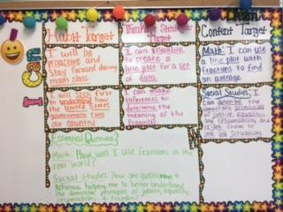
Learning Targets

Slide 4
Reflection
At the end of a lesson students have the opportunity to reflect on how they felt like they did at accomplishing the day’s targets.
This is done through:
DSA’s
Verbally Questioning
Thinking Strategies Recording Sheet

Slide 5
