Slide 1
Continuum of Growth:
Applying Thinking Strategies Across Content to Deepen Understanding
4th grade/Math- Nikki Francis

Slide 2
Holds thinking to remember and reuse
Provide tools for students to hold thinking & show students multiple ways to hold and use their thinking.
“What stuck with you?” anchor chart (Exit Slip)
Reflections at the end of the lesson and/or at the beginning of the lesson the following day.

Slide 3
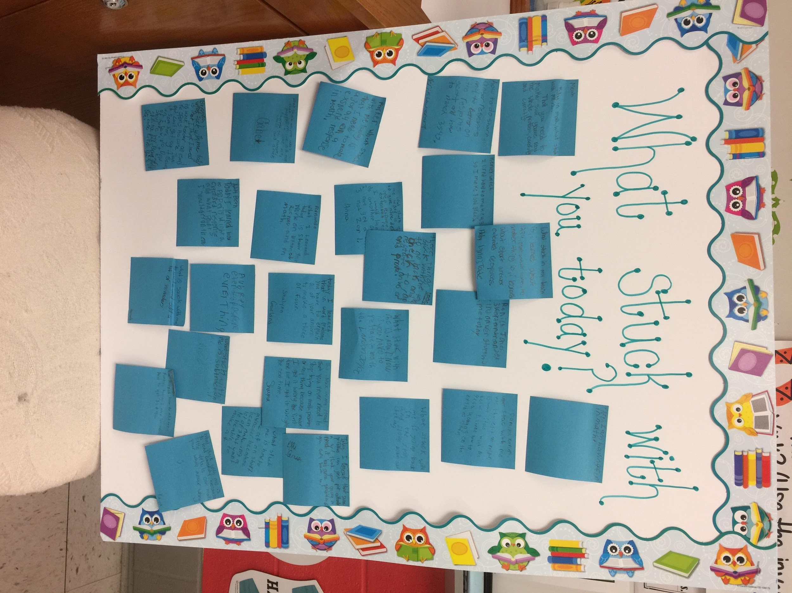

Slide 4
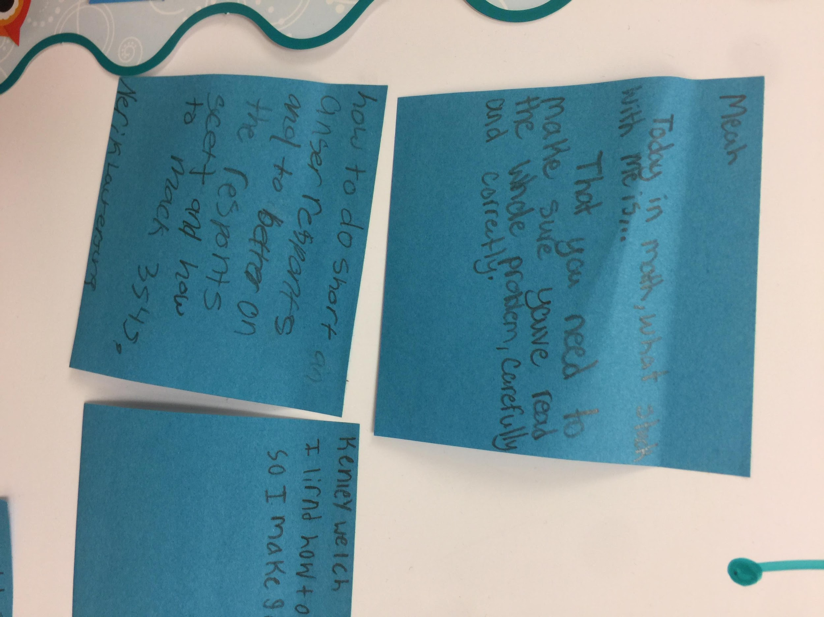

Slide 5
Next Steps..
-Invite students to reflect on which ways of holding their thinking serve them best in different contexts.
-Create ongoing needs for carefully “held” thinking.
-Offers structures for students to store and access “held” thinking over time.
Implementing an Interactive Math Notebook.

