Slide 1
Planning for Understanding
Plans for Inquiry

Slide 2
Thinking Routines
Where did I stand before this school year?
Why use thinking routines?
Promote student engagement
Create true understanding of content
Independence of all learners

Slide 3
What is Visible Thinking?
Thinking routines are in addition to other great things we have already been doing in the English Department
The first step, was making sure that I had strong essential questions for each unit
Then, as I got ready to plan a workshop, I asked the question, “What kind of thinking do I want my students to do?”

Slide 4
What is Visible Thinking?
Thinking became visible through the use of questioning, listening, and documenting
They asked questions
I asked questions, “What makes you say that?”
And I answered their questions with more questions
This task became easier as the semester progressed, but it is challenging for some who WANT TO KNOW THE RIGHT ANSWER.

Slide 5
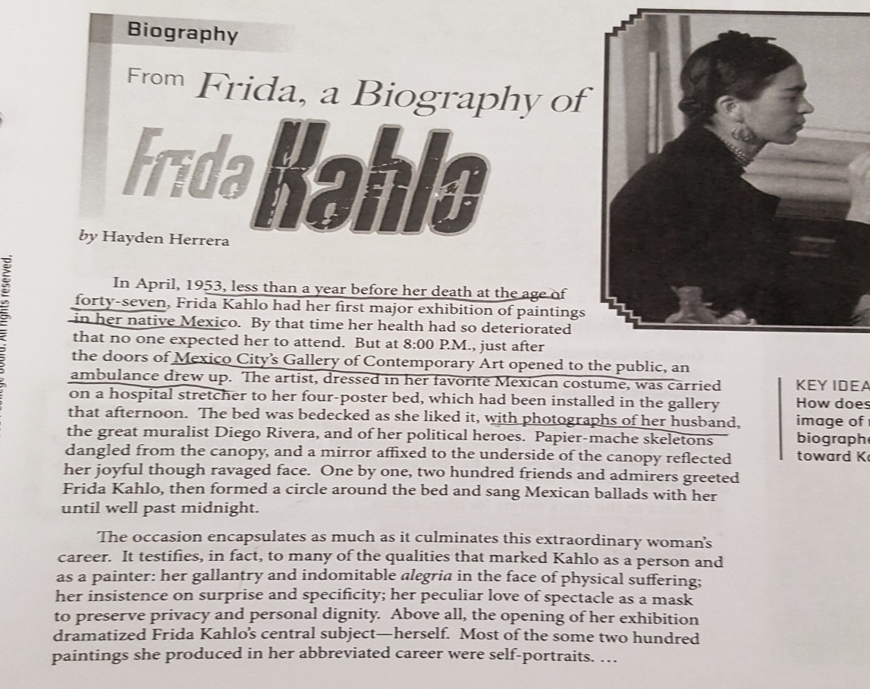
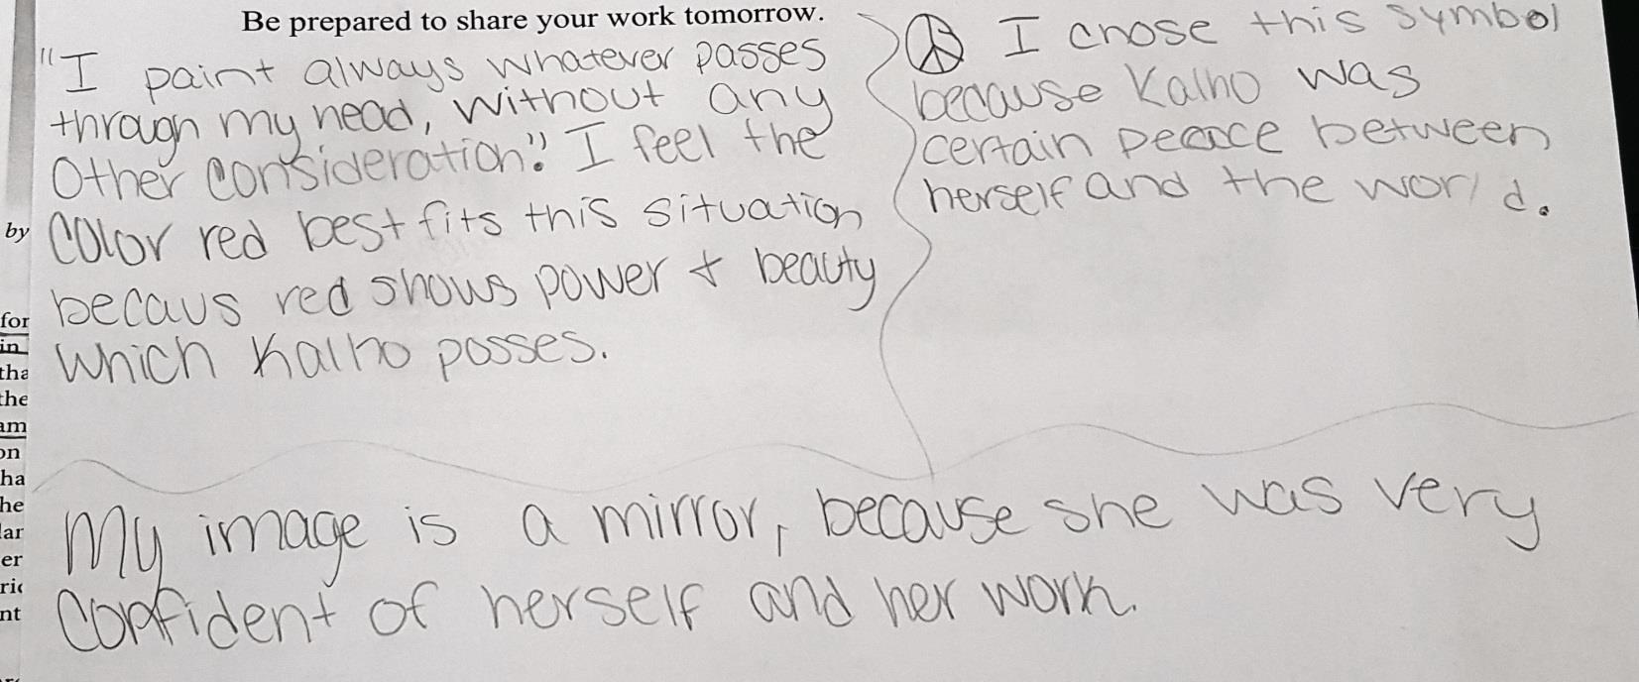
Color, Symbol, Image

Slide 6
Tug of War

Slide 7
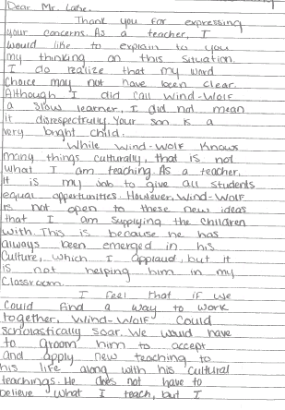
Tug of War

Slide 8
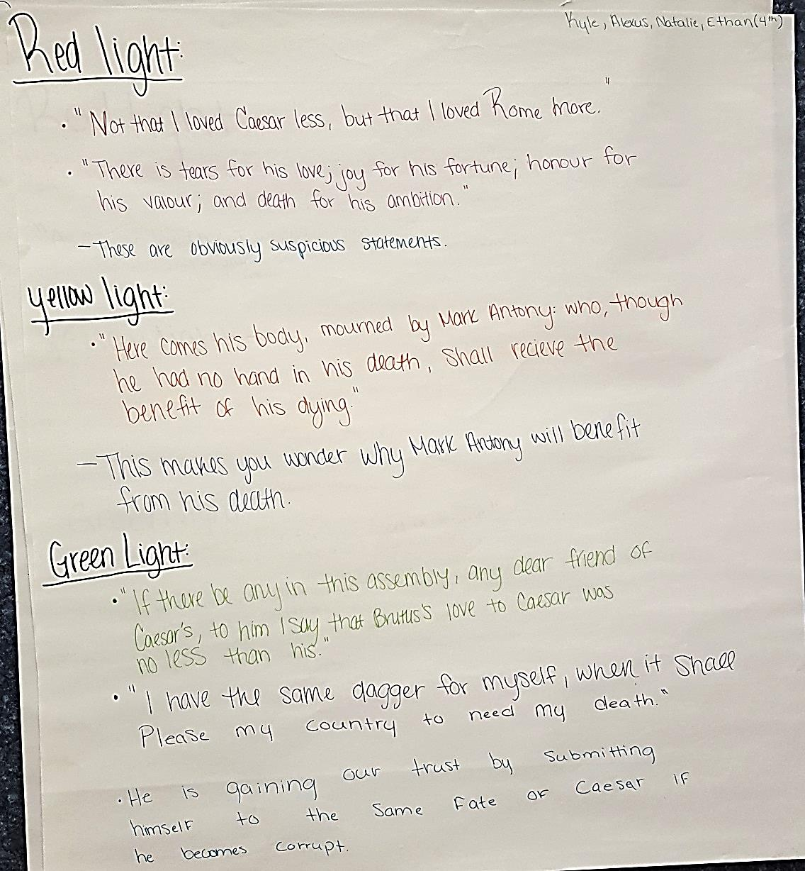
Red Light, Yellow Light, Green Light

