Slide 1
Continuum of Growth: Applying Thinking Strategies Across Content to Deepen Understanding/Teaching Thinking Strategies to Build Understanding.
4th Grade/ELA -Lori Tabor

Slide 2
Centers
Teacher Station
Vocabulary
Read to Self
Read to Write

Slide 3
Thinking Strategies

Slide 4
Reflection
Students reflect during each station and keep a tally sheet with them as they complete each station. This allows them to hold their thinking.
At the end of the class the students count the tallies to see what strategies they used most. Then, the students reflect by journaling. As they are writing they will connect the thinking strategies they used to any center.

Slide 5
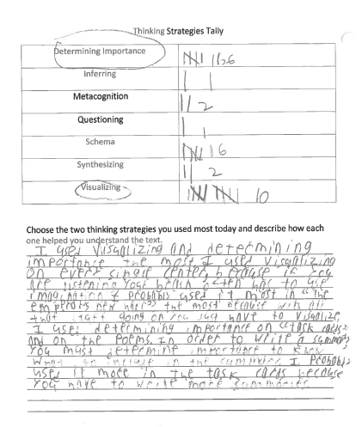
Student Examples

Slide 6
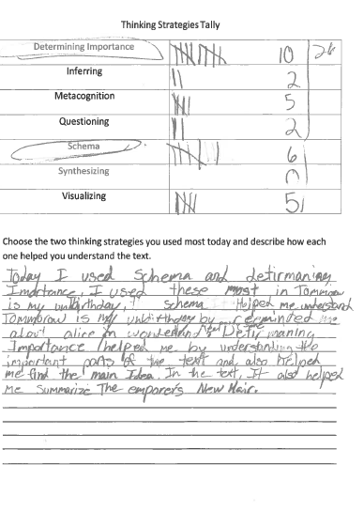
Student Examples

