Slide 1
Continuum of Growth: Applying Thinking Strategies Across Content to Deepen Understanding
5th Grade/ELA -Baillie York

Slide 2
Sets learning goals related to thinking strategies
Encourage students to create goals for their own learning and thinking strategy use – through the use of DSA, reflecting on a specific strategy that students used and explaining how it helped them complete the task​

Slide 3
In CAFÉ, students are given different types of task to have an opportunity to reflect on varied thinking strategies ​

Slide 4
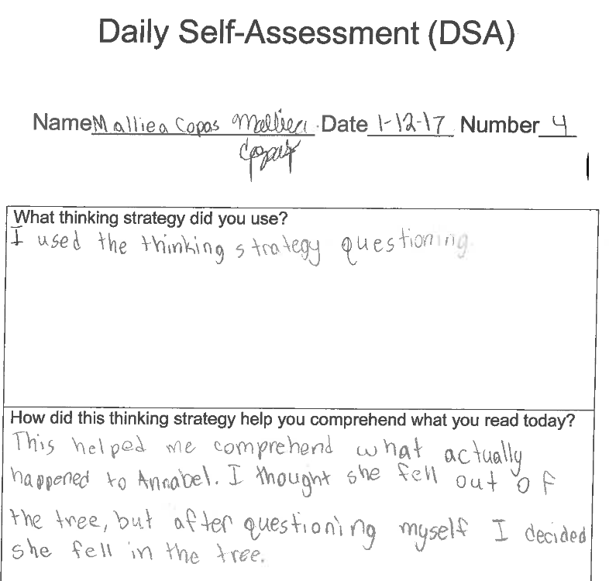

Slide 5
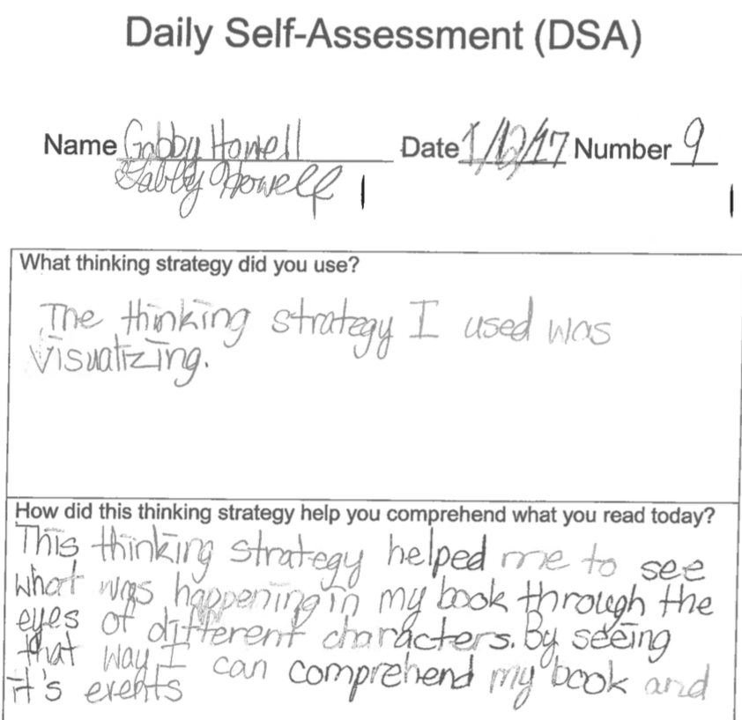

Slide 6
Incorporate the TS in the daily learning targets (I CAN statements)
I can use questioning to comprehend the poem.
I can identify the theme by determining importance.

